Slide 1
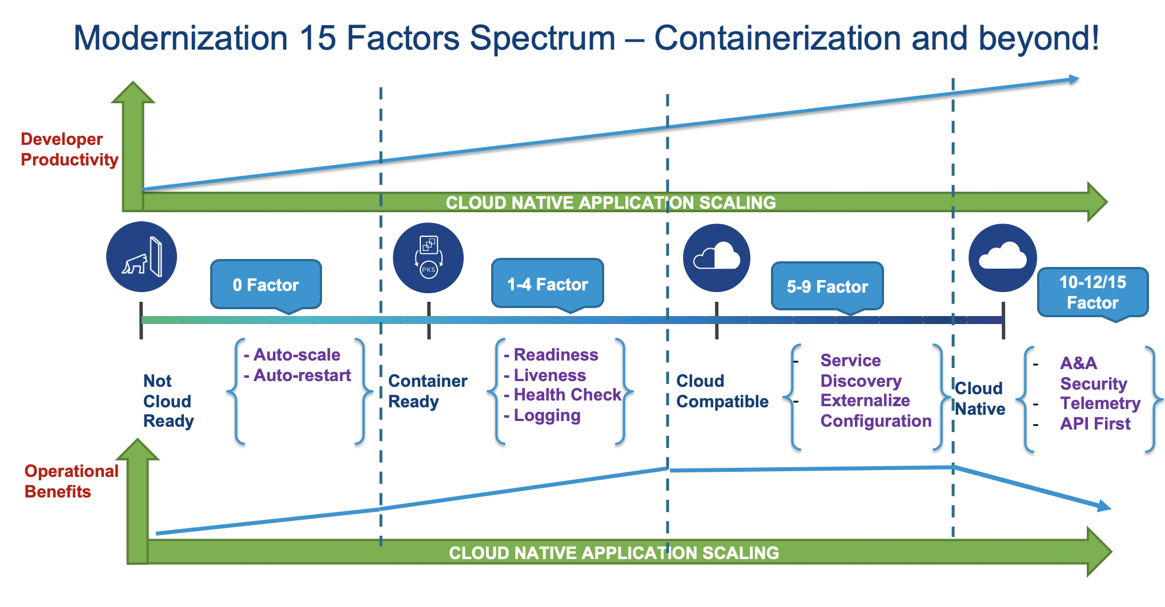
Development Architecture
15 Factors App
For Further Exploration –
12- Factor apps/15- Factor Apps of Modern Cloud Native application
Cloud native Fifteen Factor Apps - Nilesh Gule's Technical Blog

Slide 2
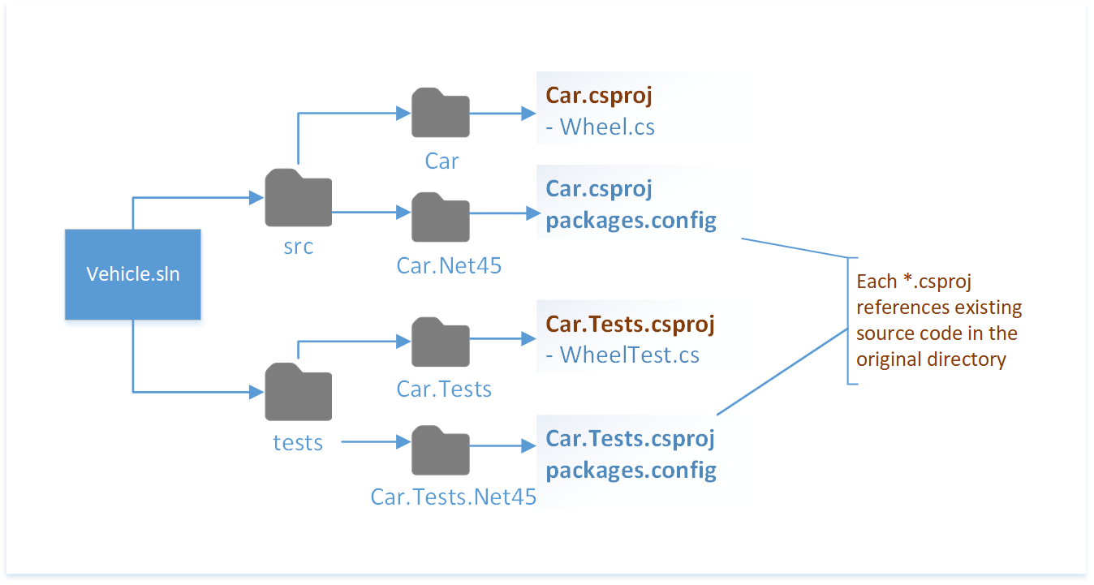
Development Architecture
Project Structure
For Further Exploration –
Organize projects for .NET Framework and .NET - .NET Core | Microsoft Learn

Slide 3
Development Architecture
Dependency Management Tools
Pip installs system and project-level Python packages.
Maven manages dependencies and the build process for Java projects.
Homebrew simplifies package installation for Mac and Linux operating systems.
Npm installs and tracks JavaScript dependencies.
NuGet manages dependencies for .NET projects.
Gradle manages dependencies and the build process for Java projects.
For Further Exploration –
How to Choose Between Package Managers: Maven, Gradle and More | Built In

Slide 4
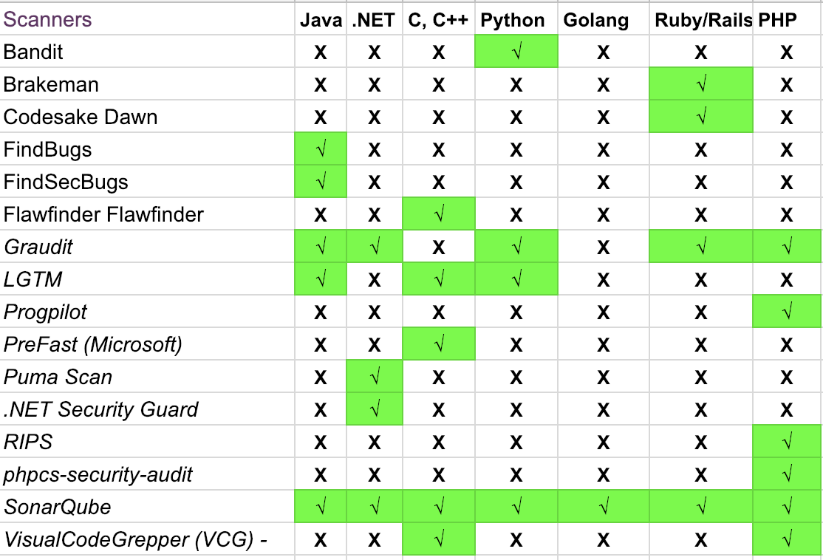
Development Architecture
Code Quality Tools

Slide 5
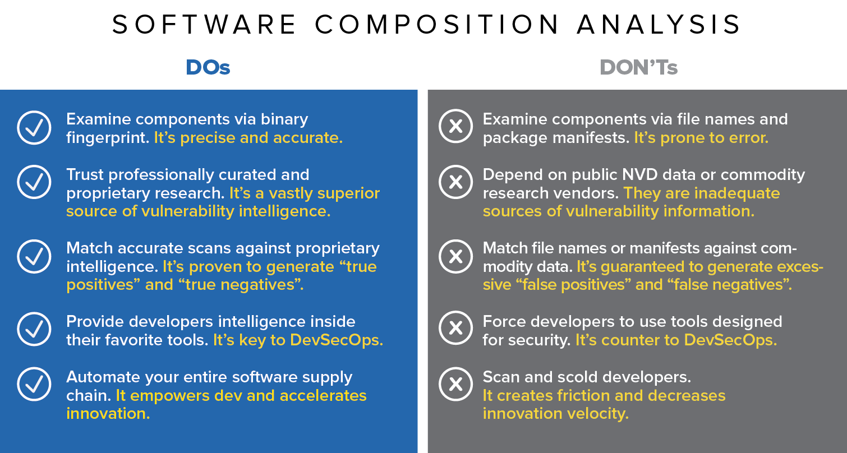
Development Architecture
SCA(Software Composition Analysis)
For Further Exploration -
What is Software Composition Analysis (SCA)? | Black Duck

Slide 6
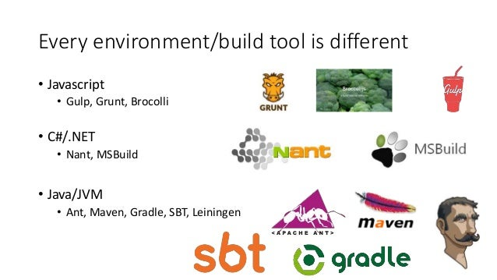
Development Architecture
Build Tools
For Further Exploration –
Top 10 Build Management Tools updated 2020 - DevOpsSchool.com
Use the MSBuild XML schema to control builds - MSBuild | Microsoft Learn

Slide 7
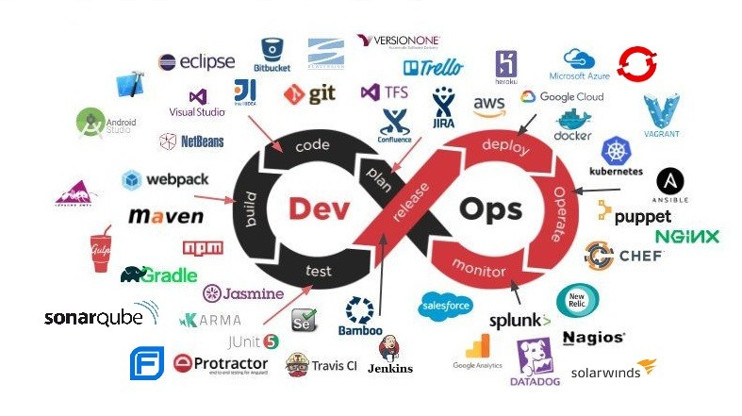
Development Architecture
DevOps
Pipeline -
For Further Exploration -
What is DevOps?? | GitLab
What is CI/CD | LinkedIn
Automate DACPAC Creation and Setup Scripts for Database Development
pgAdmin - PostgreSQL Tools
Quality Gates: Why your DevOps Pipeline needs them! - Quality Clouds
Everything as code - DevOps Guidance
Features and benefits of Red Hat OpenShift
Getting GitOps: A practical platform with OpenShift, Argo CD, and Tekton | Red Hat Developer
DevOps Culture and Practice with OpenShift | Red Hat Developer
E-books - Practical DevSecOps
Hands-On Security in DevOps | Cloud & Networking | Paperback
Shift left vs shift right: A DevOps mystery solved

Slide 8
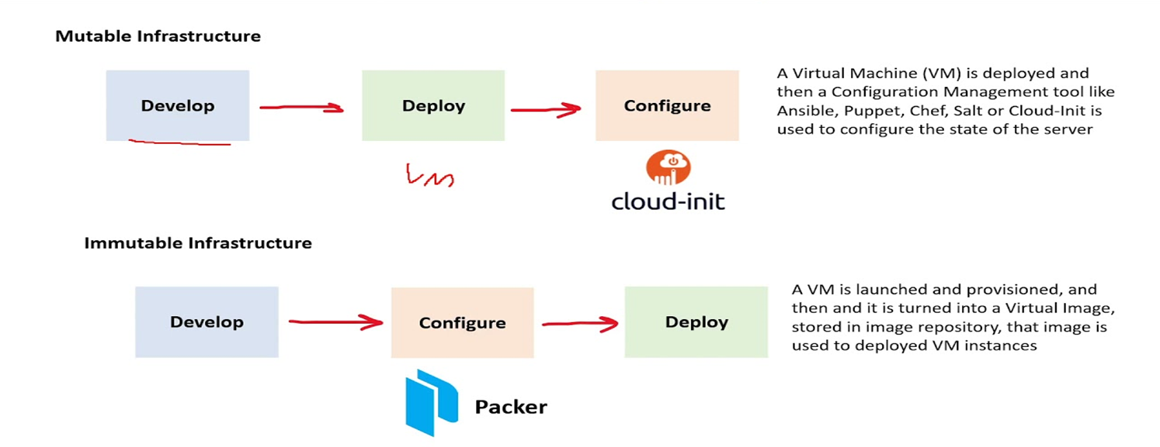
Development Architecture
DevOps
Immutable Infrastructure -
For Further Exploration –
Immutable Infrastructure: Benefits, Comparisons & More

Slide 9
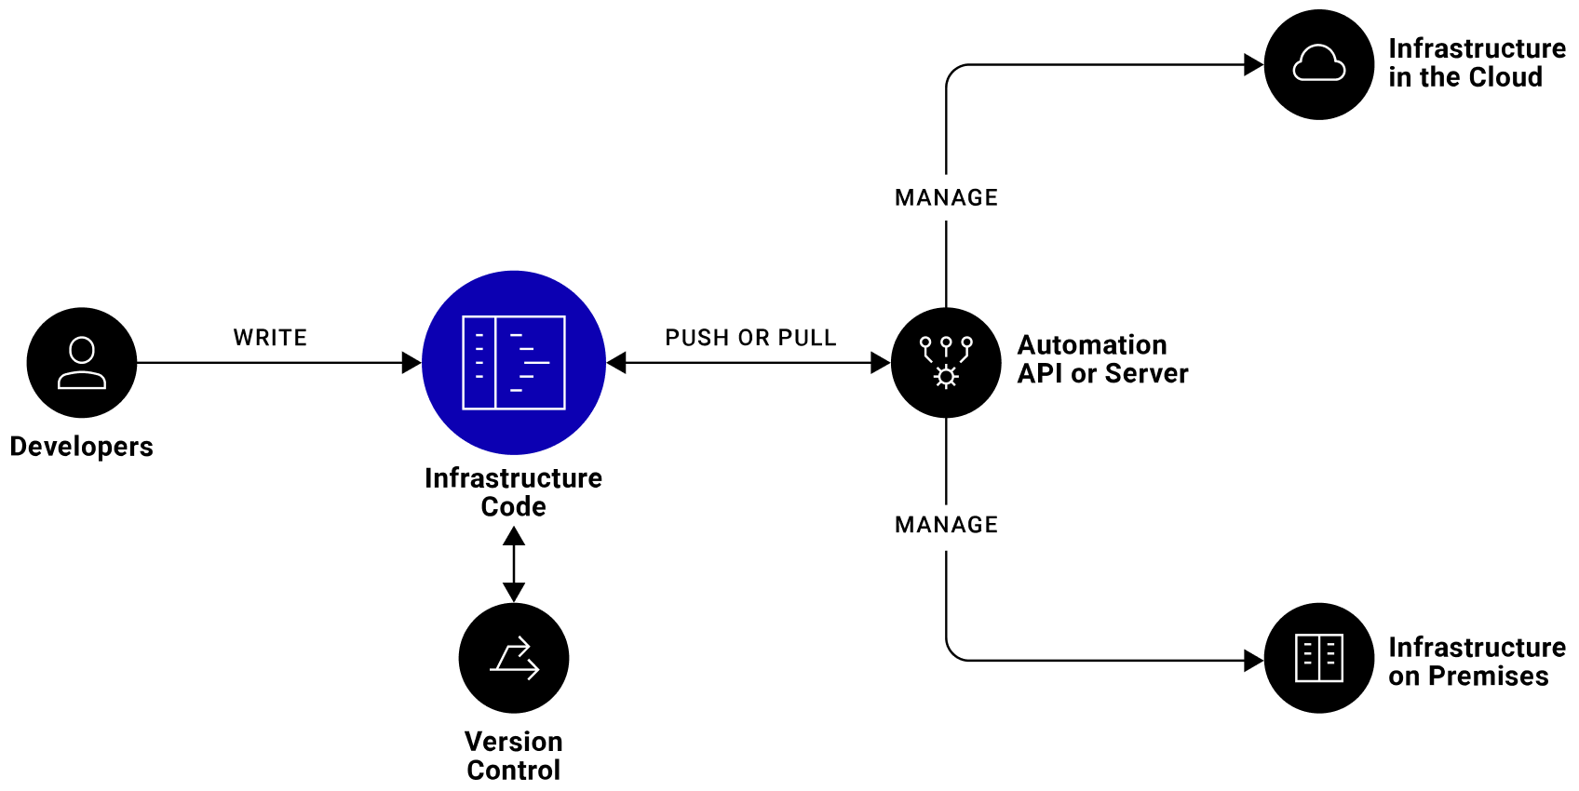
Development Architecture
DevOps
IaC(Infrastructure as Code) -
For Further Exploration -
Infrastructure as Code (IaC) vs. Configuration as Code (CaC)
Configuration as Code: Everything You Need to Know
GitOps vs GitFlow
WarpBuild - 10x faster, 90% cheaper Github Actions runners
Comparing Terraform and Bicep | Microsoft Learn
The Complete Terraform with Ansible Bootcamp 2025 | Udemy
Infrastructure-as-Code-for-Beginners
Mastering-Terraform:
Terraform-Cookbook
Master Azure Bicep: Explore Advanced Features and Techniques | Udemy
Azure Bicep: Mastering Infrastructure as Code with Bicep | Udemy
Infrastructure-as-Code-with-Azure-Bicep

Slide 10
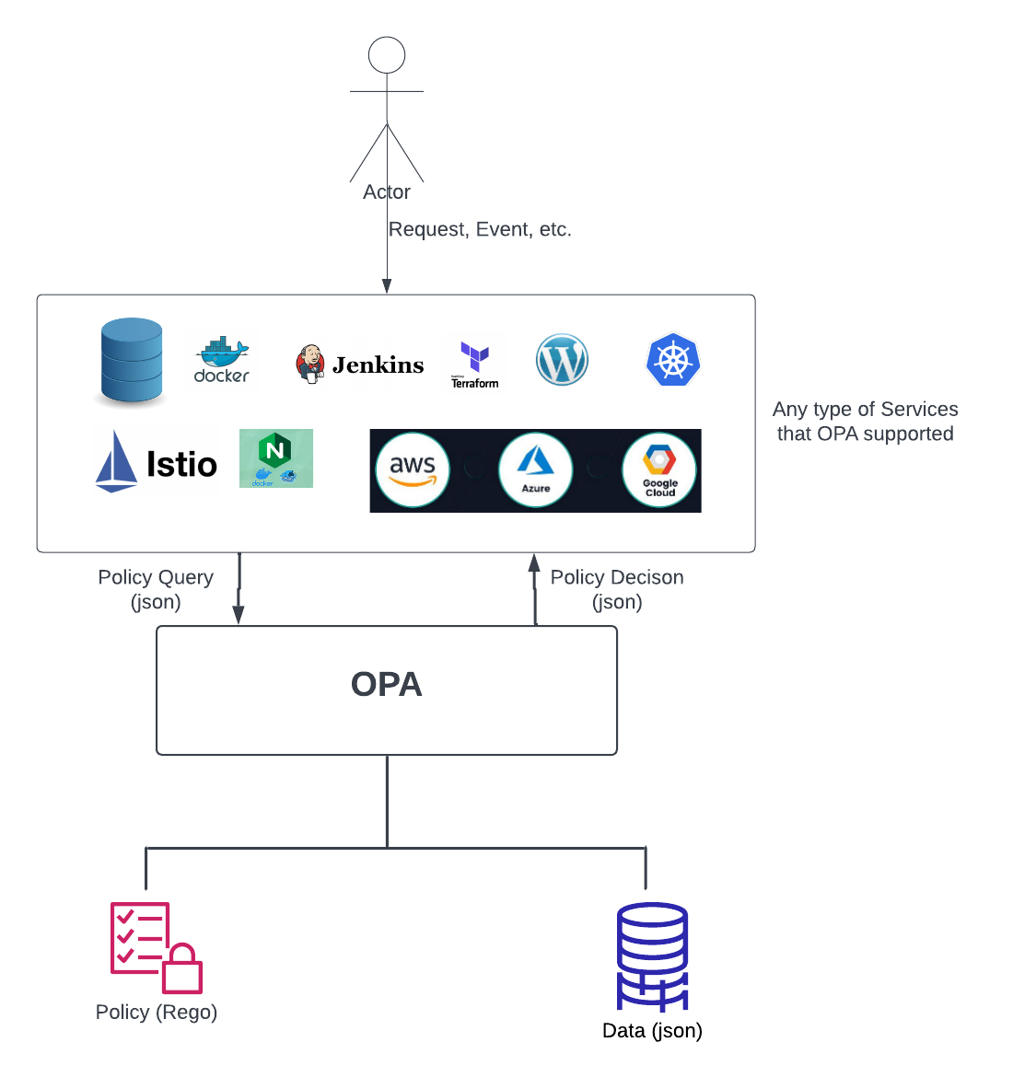
Development Architecture
DevOps
Policy as Code -
Policy as code is not only used exclusively for AuthN and AuthZ; it is a broader concept applied to managing infrastructure and operations, including infrastructure provisioning, workload orchestration, and a wide range of other operational concerns beyond just security access controls. While it is a powerful tool for implementing complex AuthN and AuthZ policies, its primary purpose is to bring code-like management to any form of operational policy.

Slide 11
Development Architecture
DevOps
Policy as Code –
How Policy as Code is Used: Infrastructure Management: Defining and enforcing policies for provisioning and configuring infrastructure resources. Workload Orchestration: Managing and governing the deployment and execution of workloads and applications. Security: Implementing AuthN and AuthZ policies to control access to resources and ensure compliance. Compliance: Automating the enforcement of regulatory and organizational compliance requirements. Cost Management: Setting policies to control cloud spending and resource utilization. Why it Extends Beyond Security: The term "policy as code" signifies the process of defining, managing, and versioning any kind of policy using code, similar to how software is developed.
This allows for: Automation: Policies are automatically enforced, reducing manual effort and human error. Version Control: Policies can be tracked, audited, and rolled back to previous versions, just like code. Scalability: Policies can be applied consistently across large and complex infrastructures. Flexibility: The same framework can be used for various operational concerns, not just security.
For Further Exploration –
What is Policy-as-Code? | Sysdig
Infrastructure as Code Testing with Azure Policy | Microsoft Community Hub
Policy Design in the Age of Digital Adoption | Cloud & Networking | Print

Slide 12
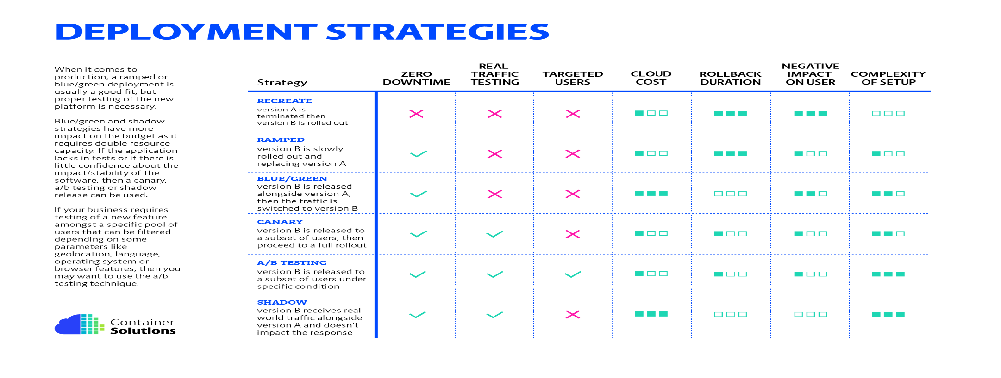
Development Architecture
DevOps
K8s supports most of the deployment strategies above.
For Further Exploration -
Achieve Zero-Downtime Deployment: Strategies and Best Practices
Zero Downtime Deployment with a Database
Azure APIM ARM deployment and ongoing traffic - Microsoft Q&A

Slide 13
Development Architecture
APIOps
✅ What is APIOps?
APIOps is to APIs what DevOps is to software.
DevOps = Automate building & deploying code.
APIOps = Automate designing, publishing & managing APIs.
Think of APIOps as:
A repeatable, automated, version-controlled workflow to design, test, secure, deploy, and govern APIs.
🤔 Why Was APIOps Needed?
Traditional APIs were deployed like this:
Developer writes API code
Writes documentation later (maybe 😅)
Manually configures gateway policies
Pushes to production
Teams struggle to maintain consistency
This causes:
Different APIs behave differently
Security policies are inconsistent
Breaking changes happen silently
Nobody knows which version does what
Time to market is slow
APIOps solves this by standardizing and automating the entire lifecycle.

Slide 14
Development Architecture
APIOps
🧠 Core Mindset Behind APIOps
Traditional API Development APIOps Way
Manual configuration Automated pipelines
Docs are afterthought API design-first
Inconsistent policies Central policy enforcement
Hard to track changes Version-controlled API definitions
Deployment is risky Incremental, tested releases
🧱 The Three Pillars of APIOps
Pillar | Meaning | Example Tools
Design-First | API contract written before implementation | OpenAPI, Swagger, Postman Collections
GitOps for API Objects | Treat API definitions as code stored in Git | GitHub, GitLab, Bitbucket
Automated API Release Pipelines | Deploy APIs using CI/CD pipelines | Azure DevOps, GitHub Actions, Jenkins

Slide 15
Development Architecture
APIOps
🚦 The APIOps Lifecycle (Very Important)
Design → Validate → Secure → Test → Publish → Monitor → Improve → Version → Repeat
1. Design
Write API spec in OpenAPI (YAML/JSON)
Define endpoints, request/response schemas, error codes
2. Validate
Check naming conventions
Enforce versioning strategy
Ensure proper status codes
Validate API structure automatically
3. Secure
Apply API gateway policies:
Rate limiting
JWT validation
OAuth2 token enforcement
IP allow/deny
WAF integration
4. Test
Contract tests (Does API follow spec?)
Functional tests (Does it behave correctly?)
Performance tests (Does it scale?)
5. Publish

Slide 16
Development Architecture
APIOps
Deploy to:
Gateway (Azure APIM, Kong, Apigee, Nginx)
Developer Portal (Docs are auto-generated!)
6. Monitor
Latency
Errors per endpoint
Traffic patterns
7. Improve
Use metrics + logs to refine usage
8. Version
Support parallel versions when breaking changes happen
🔁 A Typical APIOps Pipeline (Concrete Example)
When a developer commits openapi.yaml to Git —
Step Action Tool
1 Lint spec Spectral, Redocly
2 Generate mock APIs Prism / WireMock
3 Run contract tests Postman/Newman
4 Deploy to dev gateway CI/CD Pipeline
5 Apply security policies automatically APIM / Kong
6 Run end-to-end smoke tests K6 / JMeter
Promote to staging/production after approval GitOps deployment workflow
Everything happens automatically Consistent every time.

Slide 17
Development Architecture
APIOps
🏛️ Governance in APIOps
Governance ensures all APIs follow rules:
Policy Category Examples
Naming /customers/{id} not /getCustomerData
Versioning /v1/, /v2/
Security OAuth2 required on all production APIs
Error Format Standard JSON error bodies
Documentation Must auto-generate
Governance is enforced through tools + pipelines, not meetings.
🧰 Reference Architecture for APIOps
Developers → Git (API Spec) → CI Pipeline → API Linter → Tests
↓
API Gateway (APIM/Kong/Apigee)
↓
Developer Portal + Monitoring
🎯 Practical Tools You Will Actually Use
Function Tools
API Design SwaggerHub, Postman, Stoplight
API Validation Spectral, Redocly, Schemathesis
CI/CD GitHub Actions, Azure DevOps, GitLab CI
API Gateways Azure API Management, Kong, Apigee, AWS API Gateway
Observability Prometheus, Grafana, Splunk, APIM Analytics

Slide 18
Development Architecture
APIOps
🌍 Real-World Example Scenario
A bank exposes account lookup API to fintech partners.
With APIOps:
API spec is versioned in Git
Every change triggers open API validation & security review pipeline
Published docs update automatically on the Partner Developer Portal
Monitoring triggers alerts if latency spikes
Breaking change? → Create /v2/ and deprecate /v1/ cleanly
This improves:
Security
Compliance
Time-to-market
Developer trust
🎁 Summary (Memory Shortcut)
APIOps = OpenAPI + Git + CI/CD + API Gateway Policies + Automated Documentation + Monitoring
If a process involving APIs is manual → automate it.

Slide 19
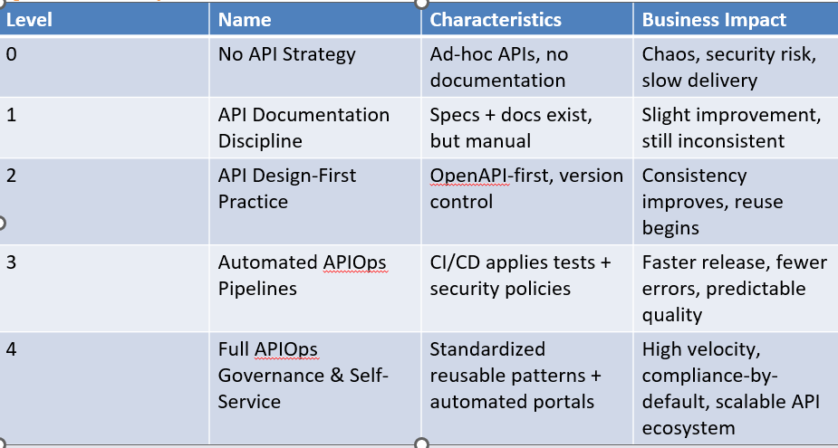
Development Architecture
APIOps
🚀 APIOps Maturity Roadmap (Enterprise-Ready)
In general, 5 maturity levels:

Slide 20
Development Architecture
APIOps
🎨 Visual Roadmap Summary (Memory Snapshot)
Level 0 → No Strategy → Chaos
Level 1 → Documentation → Visibility
Level 2 → Design-First → Consistency
Level 3 → Automated APIOps Pipelines → Quality + Speed
Level 4 → Governance + Self-Service → Scale + Reliability.
For Further Exploration
Guide to APIOps, the Collaborative Approach for API Production
APIOps: Transforming API Development with DevOps Principles
Automated API deployments using APIOps
APIOps – Documentation
APIOps-Lab
APIQuality - APIOps Low Code with artificial intelligent

Slide 21
Development Architecture
WorkerOps
1. APIOps Recap
APIOps applies DevOps-like practices specifically to APIs, covering the lifecycle from design, deployment, testing, monitoring, versioning, and governance.
Key aspects include:
Automation (CI/CD)
Observability (metrics, logs, tracing)
Governance & security
Lifecycle management
Policy enforcement
2. Background Services / Workers
Background services (e.g., cron jobs, message queue consumers, ETL processes, microservices triggered by events) have some similarities to APIs in terms of lifecycle:
They are deployed and updated continuously
They consume or produce data (via message queues, databases, or events)
They require reliability, monitoring, and scaling
So applying APIOps-like principles here makes sense.
3. “WorkerOps” / “ServiceOps” Concept
There isn’t a standard industry term like “APIOps” for background services, but the practices exist under:
WorkerOps / JobOps / ServiceOps (informal)
DevOps / SRE for background services
The idea is to treat background services as first-class deployable units with the same rigor as APIs:
CI/CD: Automatic build, test, and deploy pipelines for background services.
Example: Azure DevOps pipelines for a Service Bus triggered worker.
Observability & Monitoring: Collect logs, metrics, traces, and business KPIs.
Example: Prometheus + Grafana monitoring worker job completion, failure rates, queue length.
Scaling & Resiliency: Use autoscaling or message-driven scaling (KEDA for Kubernetes).
Example: Scale workers up/down based on Service Bus queue length.
Testing & Quality Gates: Unit tests, integration tests, chaos testing.
Example: Ensure worker handles edge cases like malformed messages or network timeouts.
Policy & Governance: Security, throttling, resource limits, retries.
4. Tools & Frameworks
You can leverage DevOps/SRE tools to implement “WorkerOps”:
Area Example Tools
CI/CD GitHub Actions, Azure DevOps, Jenkins
Monitoring Prometheus, Grafana, Application Insights, ELK stack
Autoscaling KEDA, Kubernetes HPA, AWS Lambda concurrency scaling
Testing xUnit, pytest, integration frameworks, chaos testing
✅ Summary
APIOps is API-specific, but the same lifecycle principles apply to background services.
Industry term could be “WorkerOps” or just DevOps/SRE applied to background services.
The focus is on automation, observability, scaling, reliability, testing, and governance.

Slide 22
Development Architecture
WorkerOps
3. “WorkerOps” / “ServiceOps” Concept
There isn’t a standard industry term like “APIOps” for background services, but the practices exist under:
WorkerOps / JobOps / ServiceOps (informal)
DevOps / SRE for background services
The idea is to treat background services as first-class deployable units with the same rigor as APIs:
CI/CD: Automatic build, test, and deploy pipelines for background services.
Example: Azure DevOps pipelines for a Service Bus triggered worker.
Observability & Monitoring: Collect logs, metrics, traces, and business KPIs.
Example: Prometheus + Grafana monitoring worker job completion, failure rates, queue length.
Scaling & Resiliency: Use autoscaling or message-driven scaling (KEDA for Kubernetes).
Example: Scale workers up/down based on Service Bus queue length.
Testing & Quality Gates: Unit tests, integration tests, chaos testing.
Example: Ensure worker handles edge cases like malformed messages or network timeouts.
Policy & Governance: Security, throttling, resource limits, retries.
4. Tools & Frameworks
You can leverage DevOps/SRE tools to implement “WorkerOps”:
Area Example Tools
CI/CD GitHub Actions, Azure DevOps, Jenkins
Monitoring Prometheus, Grafana, Application Insights, ELK stack
Autoscaling KEDA, Kubernetes HPA, AWS Lambda concurrency scaling
Testing xUnit, pytest, integration frameworks, chaos testing

Slide 23
Development Architecture
WorkerOps
✅ Summary
APIOps is API-specific, but the same lifecycle principles apply to background services.
Industry term could be “WorkerOps” or just DevOps/SRE applied to background services.
The focus is on automation, observability, scaling, reliability, testing, and governance.

Slide 24
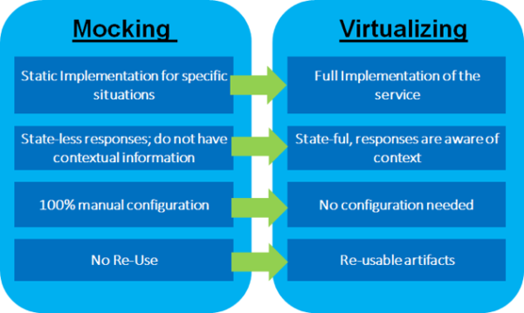
Development Architecture
Service Virtualization/ APIs Mocking -
For Further Exploration –
Service Virtualization. In the best of all possible worlds… | by Pradeep Kumar HK. | Medium
Configure and use a Postman mock server | Postman Learning Center

Slide 25
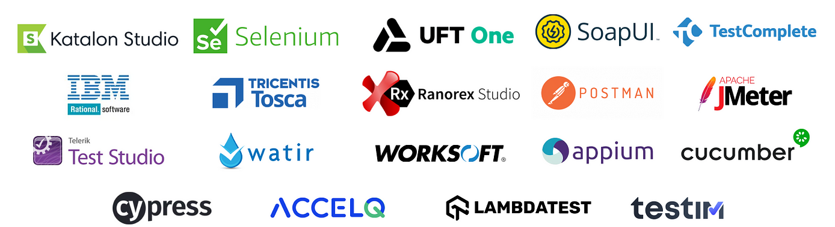
Development Architecture
Functional Testing -
The 3 most important things to address w.r.t any functional testing are Test Scenarios(what to test, less detailed & more broader), Test Cases(how to test, more detailed, less broader) & Test Data. Also Test cases are in general derived from Test Scenarios.
For Further Exploration-
Full Stack Testing: A Practical Guide for Delivering High Quality Software
DevOps Test Automation | Atlassian
Software Testing Strategies | Programming | eBook
Page Object Model and Page Factory in Selenium | BrowserStack
What are the common challenges and pitfalls of using Page Object Model and how do you overcome them?
Challenging the Page Object Model | by SebasViquez | Medium
How do you test APIs that use asynchronous communication?
Consumer-Driven Contract Testing (CDC) - Engineering Fundamentals Playbook
Playwright
Playwright-Python-and-Pytest-for-Web-Automation-Testing
Hands-On Test Management with Jira | Business & Other | eBook
Test Execution - Zephyr Standalone 6.1 & 6.2 – Confluence
Use scripts to add logic and tests to Postman requests | Postman Docs
Allure Report — Open-source HTML test automation report tool

Slide 26
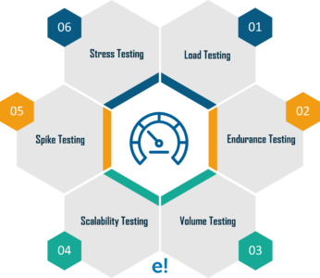
Development Architecture
Performance Testing -
For Further Exploration-
Why averages suck and percentiles are great
Load Testing
Measure performance in Visual Studio - Visual Studio (Windows) | Microsoft Learn
JMeter Tutorial: Getting Started with Jmeter
How you should be load testing your background services Asynchronous API Performance Testing with JMeter
BenchmarkDotNet: Powerful .NET library for benchmarking

Slide 27
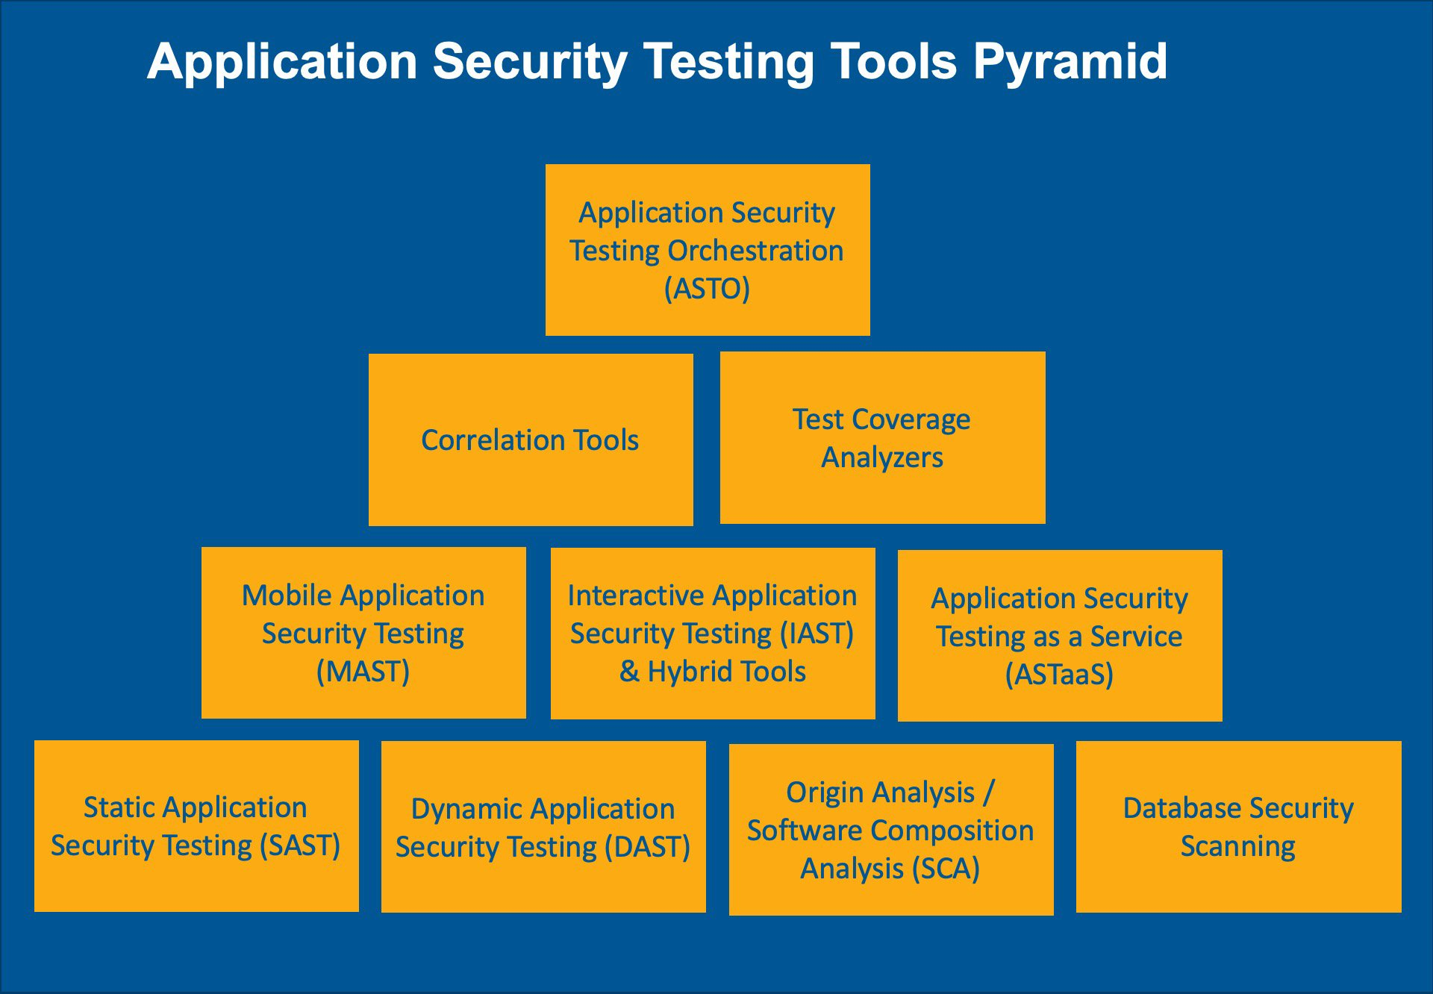
Development Architecture
Security Testing -
For Further Exploration -
Differences Between SAST, DAST, IAST, And RASP
10 Types of Application Security Testing Tools: When and How to Use Them
GitHub - iriusrisk/bdd-security: BDD Automated Security Tests for Web Applications
Security Scanning Tools: Enhancing Application Security

Slide 28
Development Architecture
Chaos Engineering –
Chaos Engineering is the use of experimental and potentially destructive failure testing into any part of the stack (compute, storage, network or application infrastructure) to uncover vulnerabilities and reduce uncertainty when building complex distributed systems.
At the most basic level, application chaos can be created by exposing some “/error”[fault injection] endpoint and giving access to the endpoint only to some specific service account/principal & then checking how the system behaves.
System Level real world chaos can be simulated by deleting resources or shutting down components & checking how the system behaves but that is very risky and should be done after following proper governance process around the same.
Chaos testing is very helpful to test Alerts(and relevant Runbooks pointed by the Alerts).Just like any other type of Testing, Chaos Testing can also be done manually or using unit/automation tests as well.

Slide 29
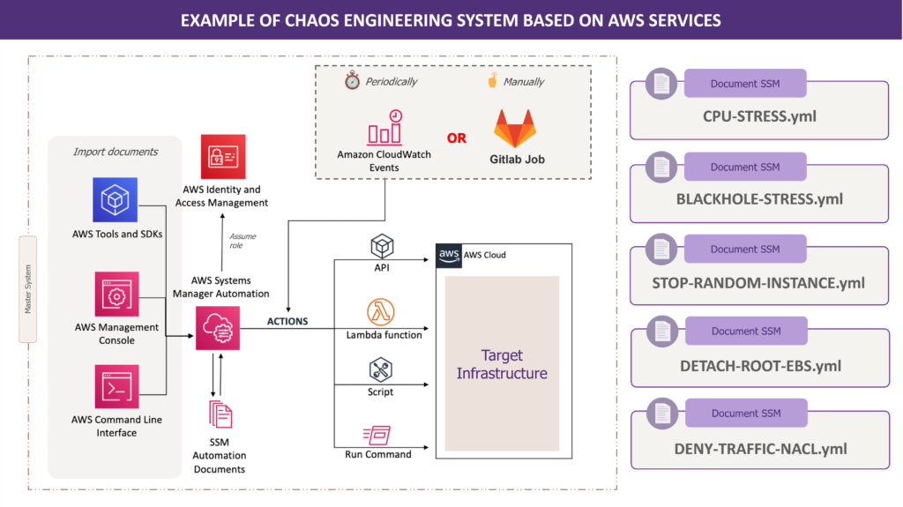
Development Architecture
Chaos Engineering –

Slide 30
Development Architecture
Chaos Engineering –
For Further Exploration –
Chaos Engineering: the history, principles, and practice
Building resiliency with chaos engineering | Thoughtworks Australia
The Chaos Engineering Maturity Model
Introducing Litmus 2.0 - Simplify Chaos Engineering - DEV Community
How to Test Your Fault Isolation Boundaries in the Cloud - InfoQ
Azure Chaos Studio - Chaos engineering experimentation | Microsoft Azure
Chaos Engineering using Azure Chaos Studio | Udemy
Kube-Monkey
Create an experiment using a Chaos Mesh fault with the Azure portal
Chaos Engineering with Chaos Toolkit | Udemy
Resilience and chaos engineering - .NET Blog(this resource is helpful mainly to chaos test the dependencies of a component e.g. some dependency API went down, while most of the other resources mentioned here are mainly to chaos test the component itself)
Start with chaos engineering in C# | by Jeroen Verhaeghe | Medium
UnmeshJoshi/Tickloom

Slide 31
Development Architecture
Technical Debt Management (Techniques)
Technical debt management involves a combination of preventative measures and remedial actions, such as establishing code quality standards, implementing automated testing and code reviews to prevent new debt, and creating a technical debt backlog to systematically address existing issues through refactoring and prioritization. A continuous approach is key, which includes allocating time for debt reduction within development sprints and fostering a culture of quality and continuous improvement among the team
Preventative techniques
Establish quality standards:
Define clear guidelines for code quality, architecture, and development practices to reduce the creation of new debt.
Implement code reviews:
Use peer reviews to catch and fix potential issues before they become technical debt.
Automate testing and integration:
Set up automated tests and continuous integration (CI) pipelines to catch bugs early and ensure new code doesn't introduce new debt.
Improve documentation:
Maintain up-to-date and accurate documentation to reduce knowledge gaps and facilitate maintenance and refactoring.
Regularly update systems:
Keep libraries and dependencies updated to prevent compatibility and security issues.
Conduct architecture reviews:
Periodically assess the system architecture to ensure it still meets business needs and is scalable.
Remedial techniques
Identify and prioritize:
Conduct audits to find technical debt and then create a register or backlog to track and prioritize issues based on their impact on performance, security, and maintainability.
Allocate time for repayment:
Integrate debt reduction into the development process, such as allocating a percentage of each sprint to tackle it.
Regular refactoring:
Make refactoring a regular habit to improve code quality and maintainability. This can involve "preparatory refactoring" where

Slide 32
Development Architecture
Technical Debt Management (Techniques)
you improve a section of code before adding new features.
Address high-impact issues first:
Prioritize fixing critical issues that cause performance failures or security flaws.
Cultural and process techniques
Foster a culture of continuous improvement:
Encourage a team-wide mindset of continuous learning and improvement, where quality is everyone's responsibility.
Educate and train the team:
Provide training on best practices and refactoring techniques to equip developers with the necessary skills.
Communicate with stakeholders:
Keep stakeholders informed about the state of technical debt and its impact on the project.
Integrate into workflows:
Incorporate debt management into daily routines and agile workflows, such as sprint planning and reviews.
For Further Exploration
Everything You NEED to Know About TECH DEBT
Types Of Technical Debt And How To Manage Them

Slide 33
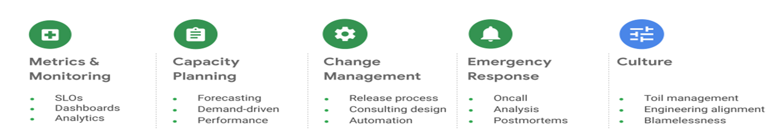
SRE(Site Reliability Engineering)
Practices –
For Further Exploration -
Site Reliability Engineering (SRE) Fundamentals
What is a Runbook? | PagerDuty
PagerDuty University
Runbook execution in Azure Automation | Microsoft Learn
Automation-Runbook-Gallery
SRE Fundamentals: Mastering Site Reliability Engineering | Udemy
Becoming-a-Rockstar-SRE: Becoming a Rockstar SRE
Real-World-SRE: Real-World SR

Slide 34
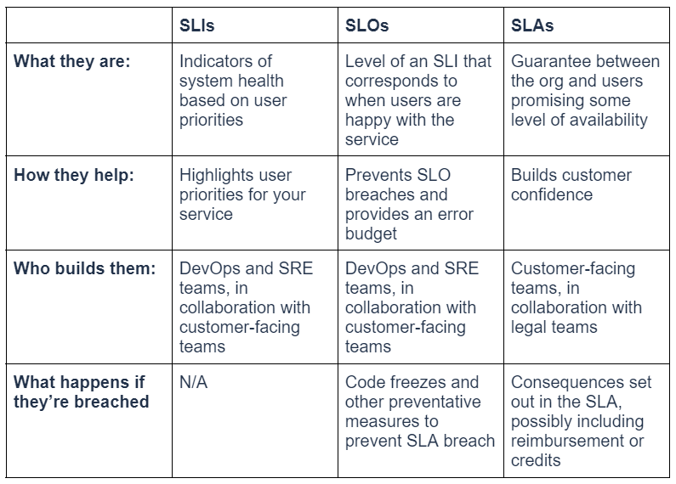
SRE(Site Reliability Engineering)
SLIs vs SLOs vs SLAs –
For Further Exploration-
SLIs and SLOs versus NFRs | Mark Rendell
Concepts in service monitoring | Google Cloud Observability
A practical guide for implementing SLO | Last9
Complete Guide to Service Level Objectives (SLOs) That Work
Mastering Service Level Objectives (SLOs): A Complete Guide | Cortex
SLOs, SLIs, and SLAs: Meanings & Differences | New Relic
Implementing Service Level Objectives[Book]
Introducing our open source SLO Tracker - A simple tool to track SLOs and Error Budget | Squadcast

Slide 35
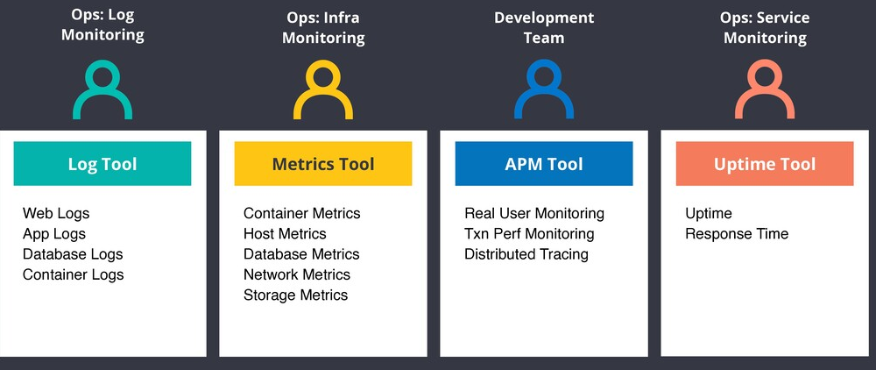
SRE(Site Reliability Engineering)
Observability/Monitoring using MELT(Metrics, Events, Logs And Traces) –
Can be used for monitoring Business Activity, Performance, Security, System Health, Cost (Controls) etc. Events are like actions taken(e.g. CRUD but can be more granular as in Event Driven DDD) & you may log them in DB as part of Auditing. By the way, any Batch Process should ideally have an associated Batch Observability table or Logs so that MELT specific stuffs w.r.t the Batch process can be tracked easily. Also, Dashboards, Alerts(if needed, based on data patterns) can be implemented based on observable data and Data Reconciliation can be done after that(if needed).Grafana is an awesome and simple tool to create Dashboards(if needed mismatched data can be seen for reconciliation as well) using logs/DB data & Grafana can create Alerts as well.

Slide 36
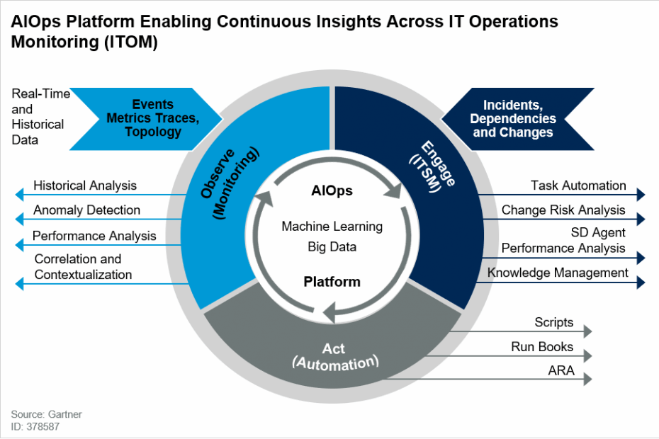
SRE(Site Reliability Engineering)
Observability/Monitoring using MELT(Metrics, Events, Logs And Traces) contd …
For Further Exploration –
What Is AIOps? Artificial Intelligence for IT Operations | Pure Storage
Point of View on DevSecOps and SRE - Key Asks and Considerations | LinkedIn

Slide 37
SRE(Site Reliability Engineering)
Observability/Monitoring using MELT(Metrics, Events, Logs And Traces) contd…
For Further Exploration-
Microservices Observability, Resilience, Monitoring on .Net | Udemy
OpenTelemetry Foundations: Hands-On Guide to Observability | Udemy
.NET Observability with Open Telemetry - .NET | Microsoft Learn
Azure Monitor Distro client library for .NET - Azure for .NET Developers | Microsoft Learn
Cloud-Native-Observability with Otel
Learning OpenTelemetry [Book]
Awesome-Opentelemetry
Awesome-OpenTelemetry
Logging in C# - .NET | Microsoft Learn (check the cool structured logging stuff as well)
Metrics Overview - .NET | Microsoft Learn
Distributed tracing - .NET | Microsoft Learn
Kusto-Query-Language(Requests, Dependencies, Exceptions & Traces [& maybe KubeEvents] are some important AppInsights tables that can be queried for various types of Analytics and Visualizations. Also, an operation spans cross-sectionally over these tables and so if you want to join across these tables, operation_Id is one of the best candidates for the same)
Join Operator - Kusto | Microsoft Learn
Mastering Aggregation Functions in Kusto Query Language (KQL)
Window functions - Kusto | Microsoft Learn
Definitive-Guide-kql
Setting up Alerts using Application Insights (the new ones) | by Nick Chapsas
Application Insights Succinctly
Azure Monitor Query client library for .NET - Azure for .NET Developers | Microsoft Learn
Azure Kusto SDK for .NET - Azure for .NET Developers | Microsoft Learn
Building an Application Insights Dashboard
Create monitoring resources by using Bicep - Azure Resource Manager
Azure Monitor Service Limits
Synthetic monitoring – Wikipedia
Fluentd vs. Fluent Bit: Side by Side Comparison | Logz.io

Slide 38
SRE(Site Reliability Engineering)
Observability/Monitoring using MELT(Metrics, Events, Logs And Traces) contd…
For Further Exploration contd…-
Logs and Telemetry
A Practitioner's Guide to Wide Events | Jeremy Morrell
Pull doesn't scale - or does it? | Prometheus
Push Vs. Pull In Monitoring Systems – Giedrius Statkevičius
Understanding Log Analytics at Scale, 2nd Edition [Book]
Honeycomb’s O’Reilly Book Observability Engineering
Open Source Observability [Book]
Observability solutions | IBM
Grafana Tutorial: Visualize Metrics, Time Series & Other Analytics | Udemy
Observability with Grafana, Prometheus,Loki, Alloy and Tempo | Udemy
Grafana Beginners to Advance Crash Course || Free Lab Access | Udemy
Implementing Enterprise Observability for SuccessKarun: Amazon.in: Kindle Store
Grafana Masterclass: Observability, Monitoring, Alerts | Udemy
Learn-Grafana-10
Observability-with-Grafana
Building IoT Visualizations using Grafana
End-to-End Observability with Grafana
with Grafana (English Edition) eBook : Reddy Yeruva, Ajay, Basavegowda Ramu, Vivek: Amazon.in: Kindle Store
Grafana-Awesome: a list of awesome Grafana resources
Awsome-Grafana: A curated list of amazingly awesome Grafana resources.
Awesome-Grafana
Prometheus | The Complete Hands-On for Monitoring & Alerting | Udemy
Mastering-Prometheus
Hands-On-Infrastructure-Monitoring-with-Prometheus
Modern-Network-Observability
Awesome-Prometheus: A curated list of awesome Prometheus resources, projects and tools.
How to monitor Istio, the Kubernetes service mesh | Sysdig
How to Monitor Azure Service Bus? - A Detailed Guide
What is the ELK stack? - Elasticsearch, Logstash, Kibana Stack Explained - AWS

Slide 39
SRE(Site Reliability Engineering)
Observability/Monitoring using MELT(Metrics, Events, Logs And Traces) contd…
For Further Exploration contd…-
Observability vs. Telemetry vs. Monitoring | Last9
Metrics, Events, Logs, and Traces: Observability Essentials | Last9
Azure Monitoring Complete Guide (2025)
Cloud-Observability-with-Azure-Monitor
Building SRE from Scratch. Introduction to site reliability… | by Ernese Norelus | Medium
Elastic Observability in SRE and Incident Response | Elastic Blog
Observability from cloud to edge in Azure | Microsoft Azure Blog
Guidance for Deep Application Observability on AWS
Observability Maturity Model - DZone Refcardz
The Art of Monitoring eBook : Turnbull, James, Orlando, Sid: Amazon.in: Books
Fundamentals of Trace and Log Analysis
How to track development metrics with VSCode Exporter, Grafana Agent, and Grafana Cloud | Grafana Labs

Slide 40
SRE(Site Reliability Engineering)
Observability/Monitoring using MELT(Metrics, Events, Logs And Traces) contd…
For Further Exploration contd…(Data Observability)-
What is Data Observability
Data Observability Book: Your Essential Guide to Understanding and Implementing Data Observability
Fundamentals-of-Data-Observability
Data-Observability-for-Data-Engineering
Datadog Observability (Monitoring, Logging, Alerting) in K8s | Udemy
Datadog Observability (Monitoring/Logging/Alerting) | Udemy
OpenMetadata

Slide 41
SRE(Site Reliability Engineering)
Observability/Monitoring using MELT(Metrics, Events, Logs And Traces) contd…
For Further Exploration contd…(Observability As Code)-
Observability as Code Explained: Benefits & How to Get Started
Observability as Code: What is it and Why Do You Need It?
Observability as Code - Engineering Fundamentals Playbook
Observability as Code | Grafana documentation

Slide 42
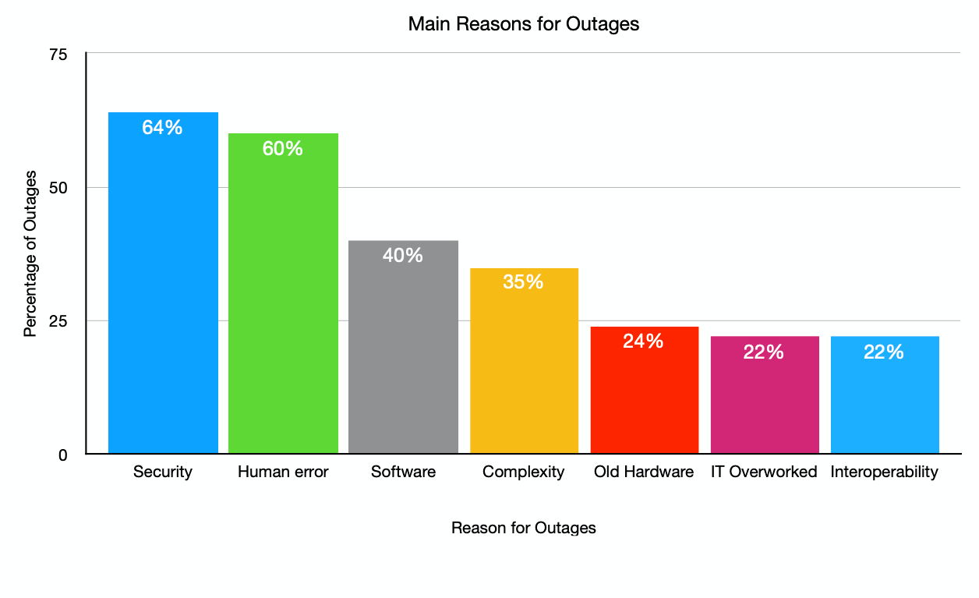
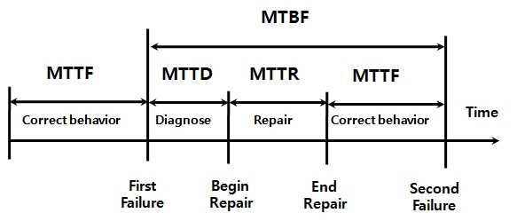
SRE(Site Reliability Engineering)
Outages –

Slide 43
SRE(Site Reliability Engineering)
Outages –
Outage in general is due to system failures(maybe due to overloading of the system). Outage Fequency is in general defined using MTBF.
A related concept is that of DownTime which is mostly considered to be due to maintenance activities. DownTime is generally related to MTTR.
For Further Exploration –
Outages are still happening - Why and how can you mitigate them
What are the best practices for ensuring your application can handle peak usage times?
4 Strategies for Punching Down Traffic Spikes - High Scalability –
Load Series: Throttling vs Loadshedding – Sarah-Marie Nothling
Spikes/Bursts/Cold Starts etc | LinkedIn

Slide 44
SRE(Site Reliability Engineering)
Incident Triage –
Incident triage is the initial process of quickly assessing, analyzing, and prioritizing incoming security alerts or potential incidents to determine their severity, impact, and urgency. By applying predefined criteria and incorporating threat intelligence, incident triage helps organizations focus resources on the most critical threats, prevent alert overload, and minimize business disruption and potential damage from security breaches. Key Aspects of Incident Triage.: Assessment and Analysis: The process begins with a rapid review of incident reports and alerts to understand the nature of the event and determine if it is a true incident or a false positive. Prioritization: Incidents are ranked based on factors like potential impact on the business, severity of the threat, and the likelihood of escalation. Resource Allocation: Triage ensures that valuable resources and attention are directed to the highest-priority incidents first, preventing burnout and wasted time on low-impact events. Threat Intelligence: Correlating incident data with known threat intelligence helps validate the incident's relevance and potential risk. False Positive Identification: A crucial part of triage is identifying false alarms to avoid wasting time and resources on non-issues. Why Incident Triage is Critical.: Efficiency: It allows incident response teams to manage a large volume of alerts efficiently, rather than addressing them in chronological order. Reduced Damage: By fast-tracking critical threats, organizations can mitigate damage and prevent security incidents from escalating into major breaches. Prevents Alert Fatigue: It helps filter through the noise of numerous alerts from monitoring tools, reducing analyst burnout. Structured Response: It provides a systematic and structured approach to managing incidents, ensuring a more organized and effective overall response.
For Further Exploration –
Service Desk Ticket Triage: How to Triage Support Tickets
The Role of Automation in Incident Triage

Slide 45
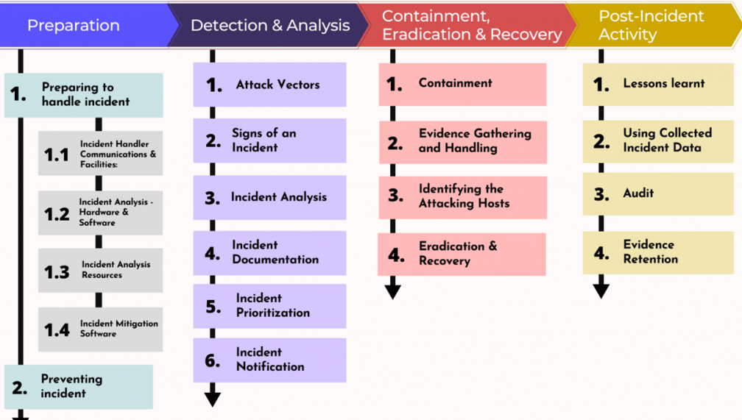
SRE(Site Reliability Engineering)
Incident Response –

Slide 46
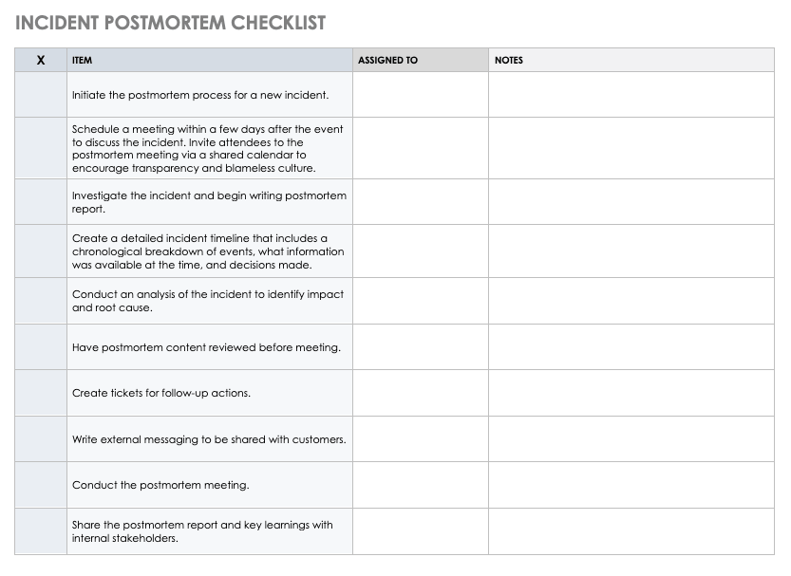
SRE(Site Reliability Engineering)

Slide 47
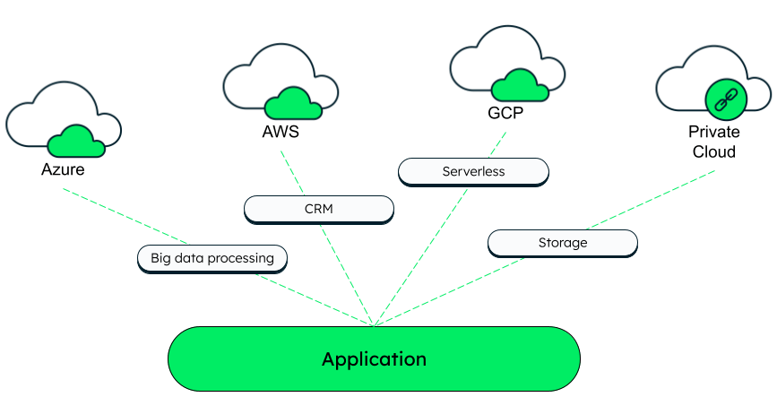
Cloud Computing
Cloud Computing –

Slide 48
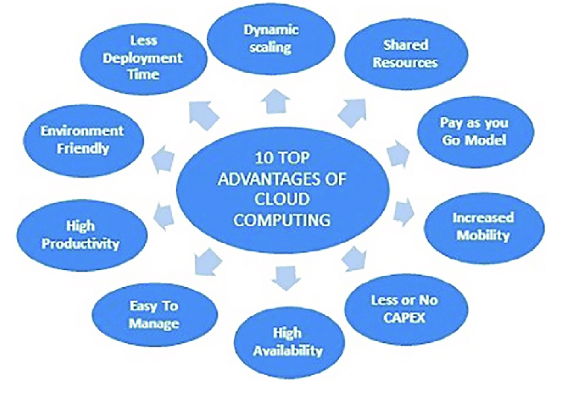
Cloud Computing
Cloud Computing(Benefits) –

Slide 49
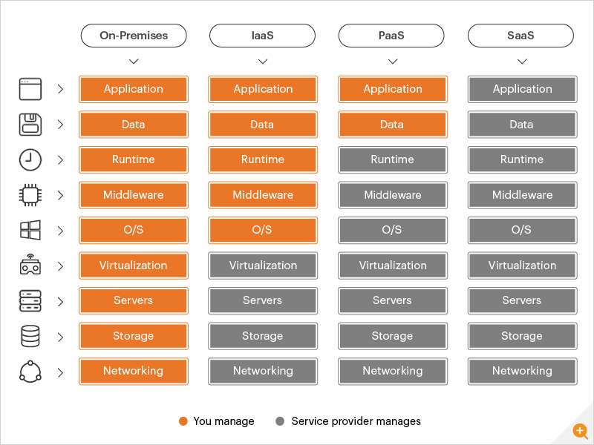
Cloud Computing
IaaS vs PaaS vs SaaS –

Slide 50

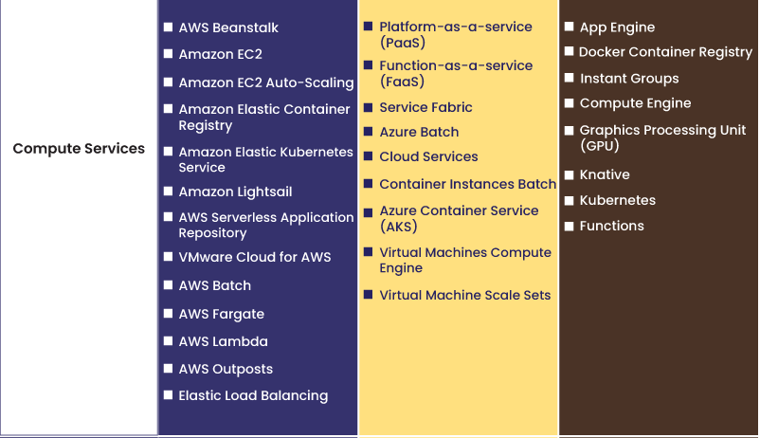
Cloud Computing
Compute -

Slide 51
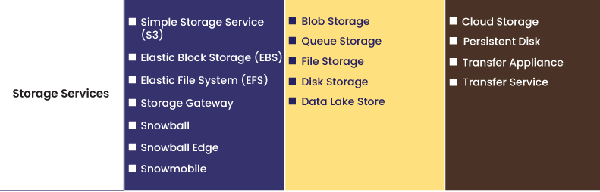
Cloud Computing
Storage -
For Further Exploration –
Learn the Differences Between Block, File and Object Storage.
AWS Transfer Family Documentation
Ambry: Distributed object store

Slide 52
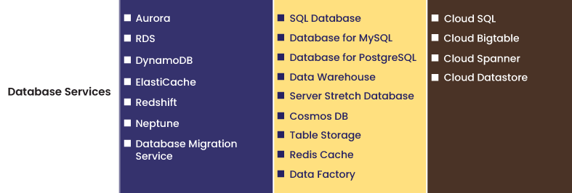
Cloud Computing
Database -

Slide 53

Cloud Computing
Serverless -
For Further Exploration –
Build ASP.NET Core APIs with Kubernetes and OpenFaaS | OpenFaaS - Serverless Functions Made Simple

Slide 54
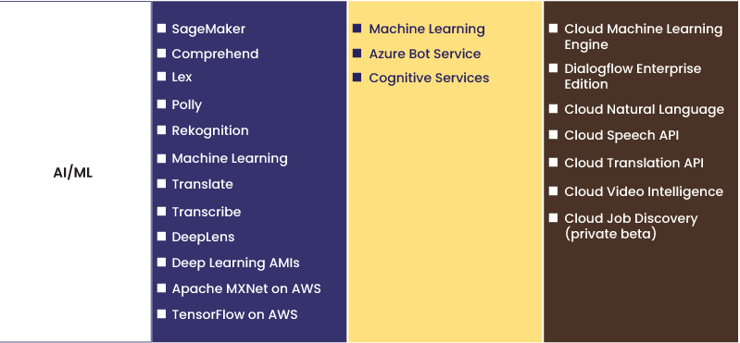
Cloud Computing
(Pre-Trained) AI Services -

Slide 55
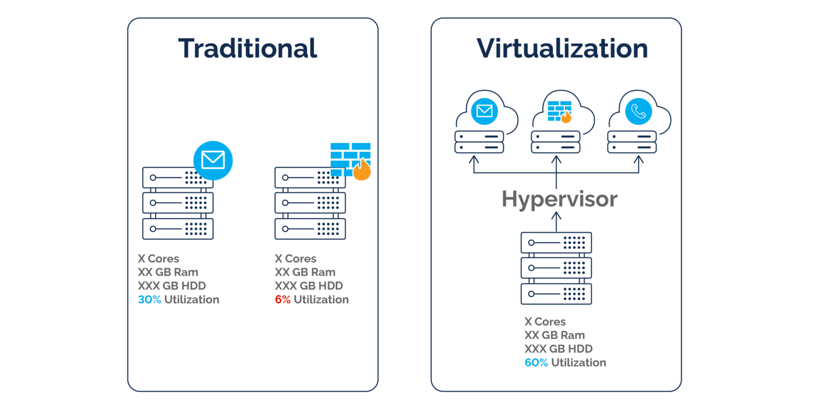
Cloud Computing
Containerization -

Slide 56
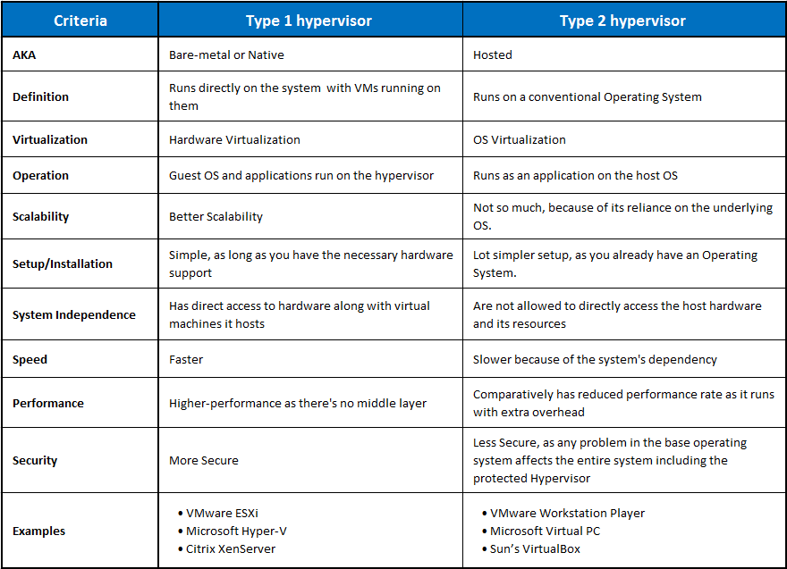
Cloud Computing
Containerization -

Slide 57
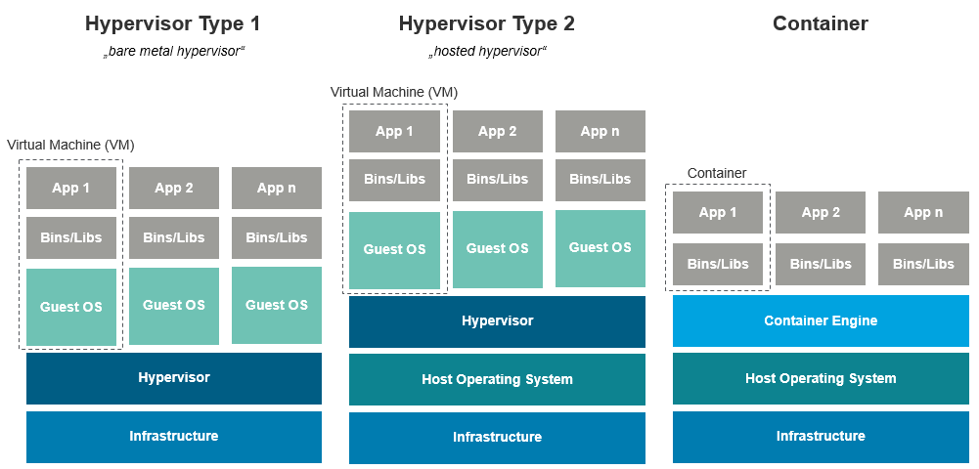
Cloud Computing
Containerization -

Slide 58
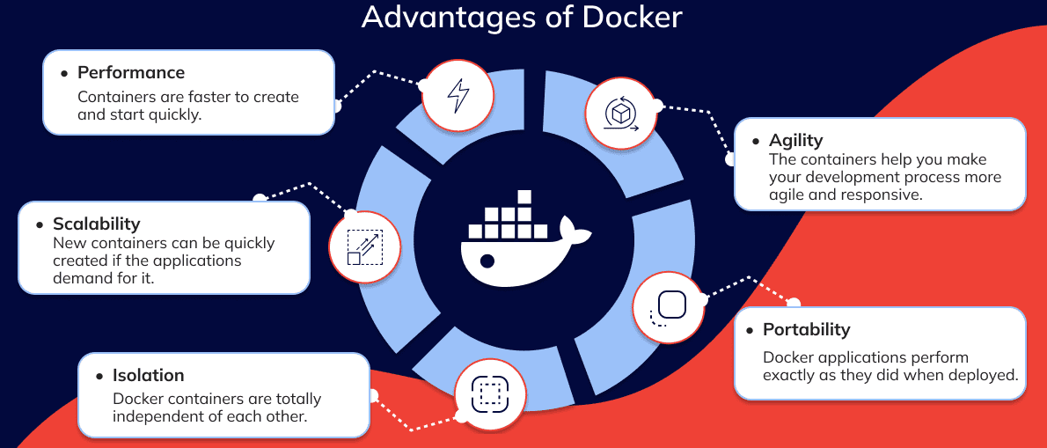
Cloud Computing
Containerization -

Slide 59
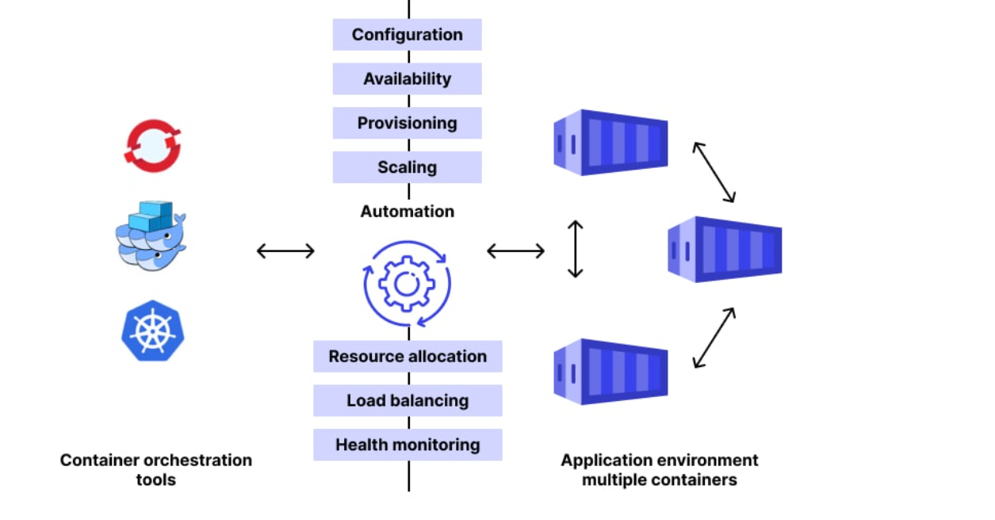
Cloud Computing
Container Orchestration

Slide 60
Cloud Computing
Container Orchestration contd…-
For Further Exploration –
What is container orchestration? | Google Cloud
Container orchestration for microservices - Azure Architecture Center
Azure Kubernetes Services (AKS) core concepts - Azure Kubernetes Service
Baseline architecture for an AKS cluster - Azure Architecture Center | Microsoft Learn
Docker and Kubernetes: The Complete Course from Zero to Hero | Udemy
Docker & Kubernetes: The Practical Guide [2025 Edition] | Udemy
Master Docker & Kubernetes | Udemy
Kubernetes-An-Enterprise-Guide
Mastering-Kubernetes
The-Kubernetes-Bible
Edge-Computing-Systems-with-Kubernetes
IoT-Edge-Computing-with-MicroK8s
Kubernetes Patterns, 2nd Edition | Red Hat Developer
Awesome-Knative: A curated list of Awesome Knative resources.
Differences between Sidecar and Ambassador and Adapter pattern - Stack Overflow How Atlassian reduced latency by 70% by using Sidecar pattern
Lens vs Komodor vs Rancher
Does Kubernetes Really Perform Better on Bare Metal vs. VMs? - The New Stack - Although in this article, its suggested to use bare metal but in a cloud environment if you want faster spawning/deployment of the container(s), use a VM or Cloud instance instead.
Cube: A simple orchestrator written in go (Manning)
What is Dev Time Orchestration? | Microsoft Learn
.NET Aspire Concepts: Orchestration, Integrations, and Service Discovery
.NET Aspire: A Game-Changer for Cloud-Native Development?

Slide 61
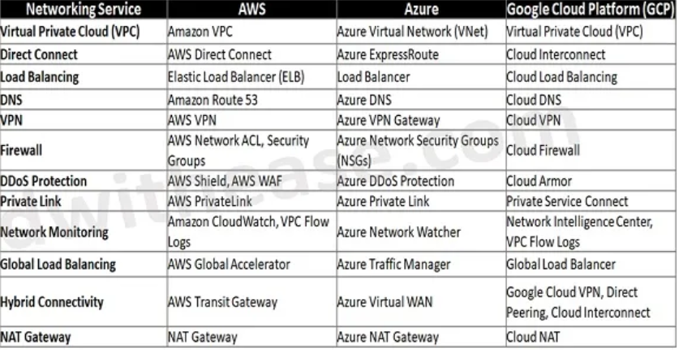
Cloud Computing
Networking –
Basics –
IP Address Format and Table – javatpoint
What is CIDR? - CIDR Blocks and Notation Explained – AWS
AWS Networking - AWS VPC, Subnets, Security Groups, NAT Gateway & IP Addresses

Slide 62
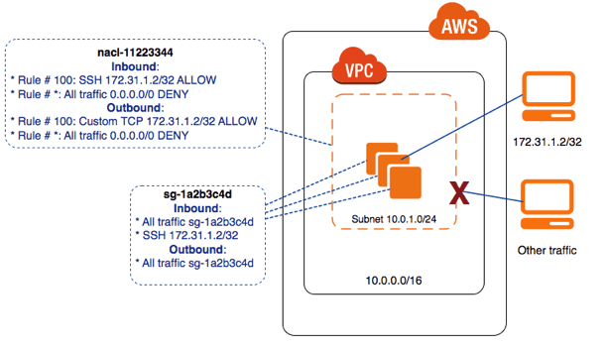
Cloud Computing
Networking –
AWS Network ACL & Security Groups –

Slide 63
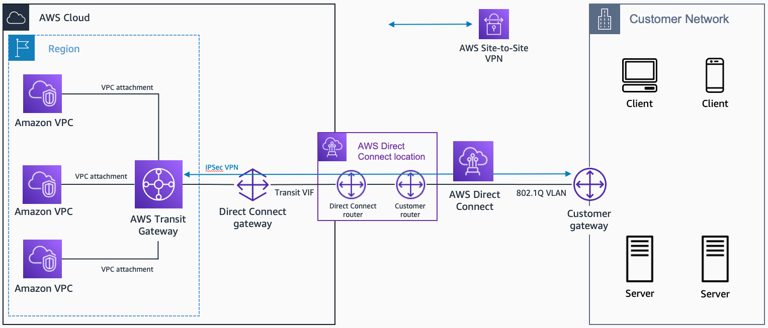
Cloud Computing
Networking –
AWS Direct Connect & Transit Gateway -

Slide 64
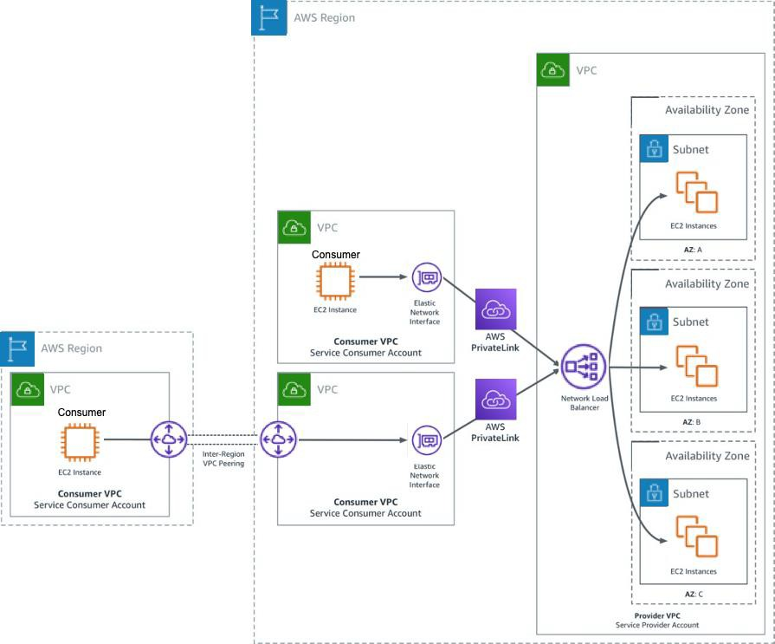
Cloud Computing
Networking –
AWS PrivateLink -

Slide 65
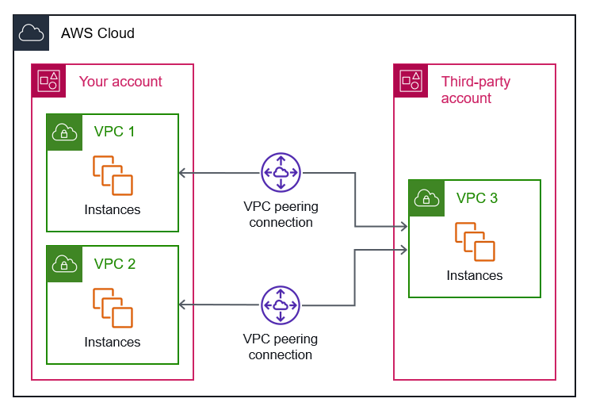
Cloud Computing
Networking –
AWS VPC Peering -

Slide 66
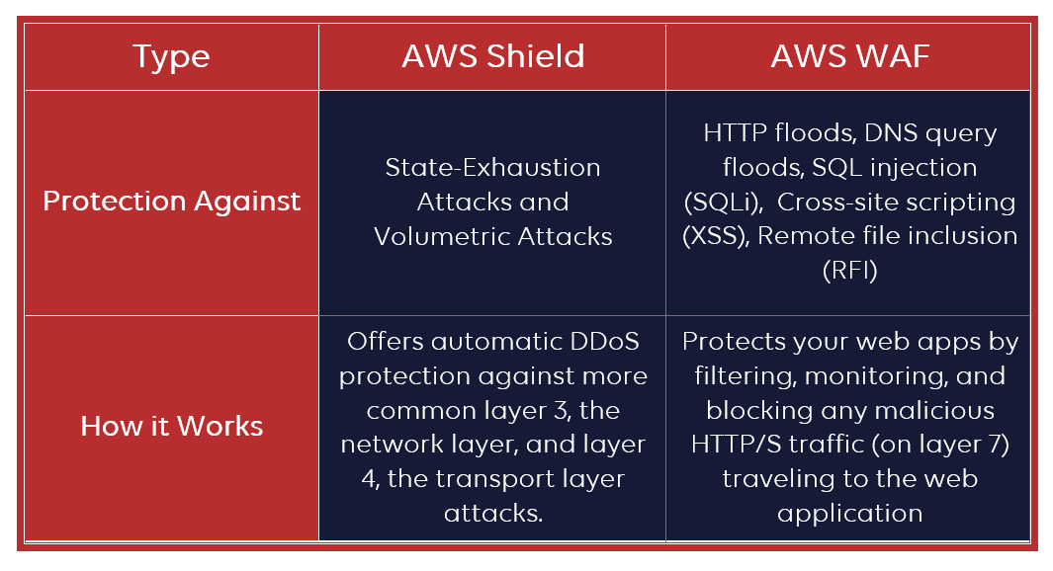
Cloud Computing
Networking –
AWS Shield vs AWS WAF -

Slide 67
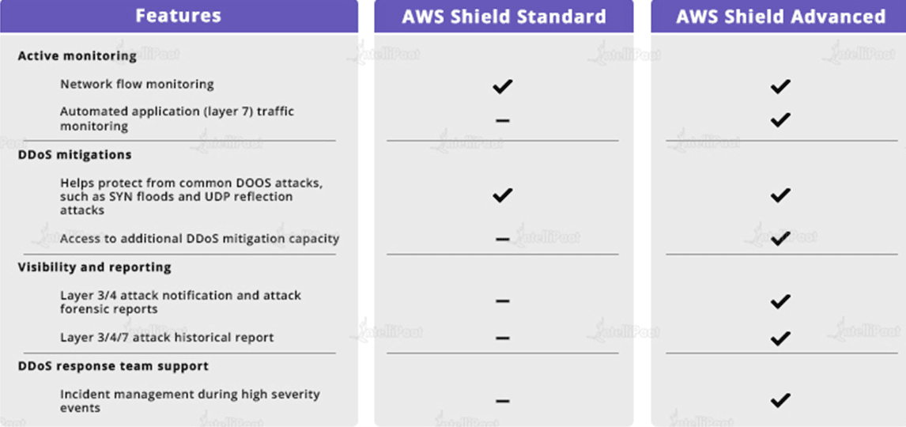
Cloud Computing
Networking –
AWS Shield(Standard vs Advanced) -

Slide 68
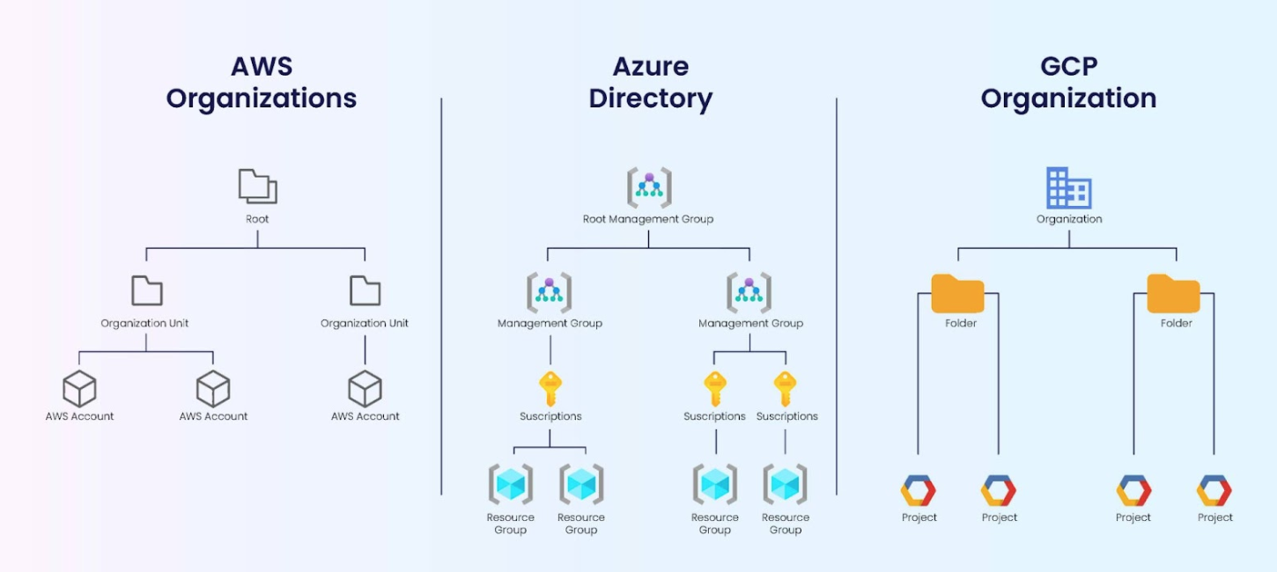
Cloud Computing
Governance via (High Level Structured) Resources –
For Further Exploration –
Organize your Azure resources effectively - Cloud Adoption Framework | Microsoft Learn

Slide 69
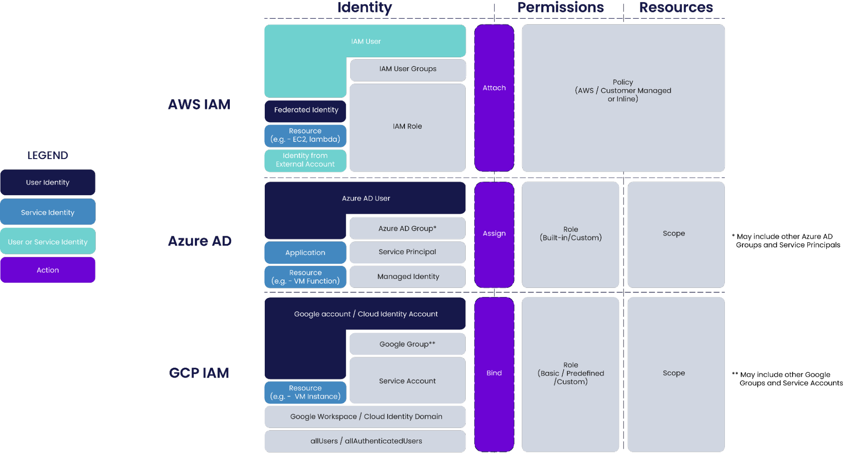
Cloud Computing
Governance via IAM –
For Further Exploration –
AWS, Azure and GCP: The Ultimate IAM Comparison - Blog | Tenable®
What is Privileged Identity Management?
Recommendations for identity and access management
Azure identity & access security best practices | Microsoft Learn

Slide 70
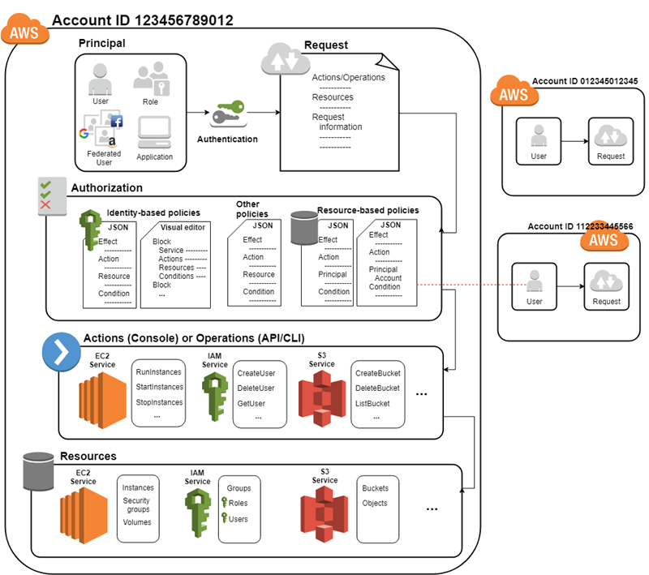
Cloud Computing
Governance via IAM –
N.B. -> The Principal can be a group(of users) or resource as well

Slide 71
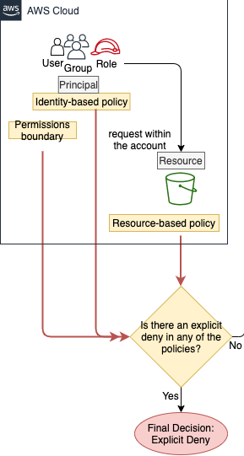
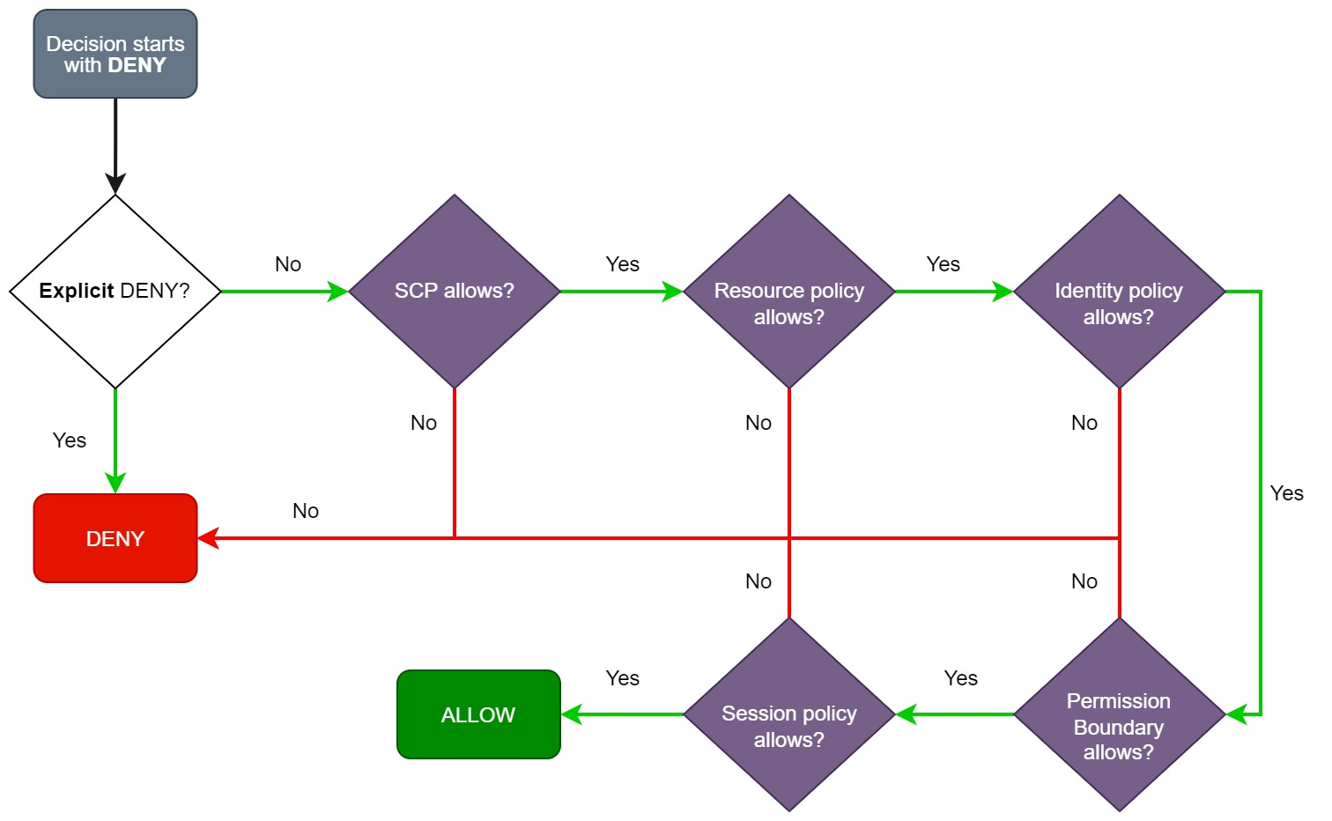
Cloud Computing
Governance via IAM –

Slide 72
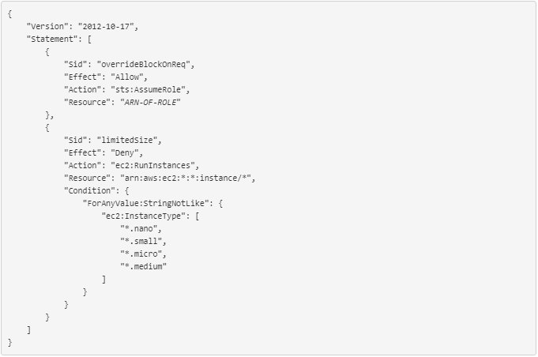
Cloud Computing
Governance via IAM –
A sample Policy Json

Slide 73
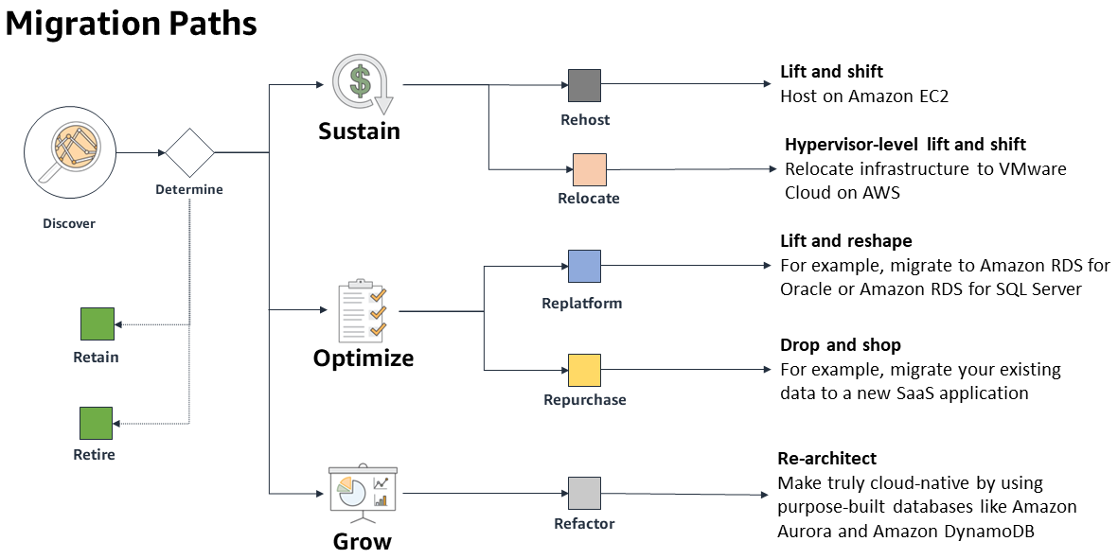
Cloud Computing
7 Rs -

Slide 74

Cloud Computing
Cloud Migration -
For Further Exploration –
CAF vs WAF: Key Differences in Cloud Adoption Strategies
App Modernization on Azure Succinctly

Slide 75

Cloud Computing
Cloud Native vs Cloud Agnostic –
For Further Exploration –
How to build cloud agnostic enterprise web applications | LinkedIn

Slide 76
Cloud Computing
Cloud Native vs Cloud Agnostic –
Features | Cloud Native | Cloud Agnostic
Portability | Difficult to move applications ported to different cloud providers. | Applications can be moved anywhere and never locked into a specific provider.
Performance | Components work on a small segment, increasing performance overall. | Wide range of features and options that customers can use to maximize performance.
Flexibility | Applications benefit from a cloud platform's built-in provisions for networking, monitoring, and other underlying architecture concerns that stymie large development efforts. | Developers are not restricted to one cloud platform's capabilities or tools and can incorporate open-source tools, libraries, and integrations.

Slide 77
Cloud Computing
Cloud Native vs Cloud Agnostic –
Features | Cloud Native | Cloud Agnostic
Resilience | Microservices enable resilience, meaning a component failure doesn’t affect the overall ecosystem. | Applications provide redundancy and improve recovery speed in the event of a failure; services can be switched to another platform if the initial platform experiences a disruption.
Costs | Customers are charged based on a combination of licensing and data storage requirements, following a pay-as-you-go model. | Cloud-agnostic architecture has greater accessibility to open-source tools, providing more direct control over costs and the ability to make spending adjustments as needed.
Implementation | Cloud native is a new paradigm that will require a cultural shift for successful implementation. | Cloud agnostic has to happen at the developer level, making implementation challenging.

Slide 78
Cloud Computing
Cloud Native vs Cloud Agnostic –
Features | Cloud Native | Cloud Agnostic
Time to Market | Pre-built templates, tools, and ready-to-use infrastructure speed up time to market for applications | The complexity of developing cloud-agnostic applications and features means that it can take longer for projects to get off the ground.
Scalability | Cloud-native systems are easy to scale up or down to meet business needs. | Cloud-agnostic apps and services can move across cloud platforms, which means they can quickly scale up to meet demand.

Slide 79
Cloud Computing
Cloud Landing Zone –
A cloud landing zone is a pre-configured, secure, and scalable environment within a cloud provider (like AWS, Azure, or Google Cloud) that serves as a foundation for deploying cloud resources and applications. It's a best-practice starting point that includes foundational elements like identity and access management, networking, security, and governance to ensure workloads can be deployed quickly, safely, and in a way that meets compliance requirements.
Key characteristics
Pre-configured environment: A landing zone is set up with specific configurations, making it a ready-to-use "base camp" for cloud projects.
Security and compliance: It's built with security and compliance policies in mind from the start, which helps avoid potential issues later on.
Scalability: A landing zone is designed to grow with your organization as you adopt more cloud-based services over time.
Multi-account structure: For environments like AWS, a landing zone often involves setting up multiple accounts to provide resource and security isolation, as explained in AWS Prescriptive Guidance.

Slide 80
Cloud Computing
Cloud Landing Zone –
Components of a landing zone
Identity and access management: Controls who can access what resources.
Networking: Designs the network architecture, including connectivity to on-premises environments and segmentation between different workloads.
Security: Implements security controls, logging, and threat detection.
Resource management and governance: Establishes a framework for managing resources, applying policies, and monitoring costs.
Logging and monitoring: Sets up systems for collecting and analyzing logs to ensure visibility and compliance.
For Further Exploration
Landing zone - AWS Prescriptive Guidance
What is an Azure landing zone
Landing zone design in Google Cloud

Slide 81

Cloud Computing
Private Cloud –
🧭 PART 1 — Grouped by Use Case
🏢 Enterprise Private Clouds
The focus is on scalability, security, compliance, and hybrid cloud integration.

Slide 82

Cloud Computing
Private Cloud –
🧭 PART 1 — Grouped by Use Case
🏭 Medium / SMB Private Clouds
Simpler, open-source, and cost-effective alternatives to enterprise suites.

Slide 83

Cloud Computing
Private Cloud –
🧭 PART 1 — Grouped by Use Case
☁️ Kubernetes / Developer-Focused Private Clouds
Ideal for cloud-native applications, DevOps, and microservices.

Slide 84

Cloud Computing
Private Cloud –
🧭 PART 1 — Grouped by Use Case
🌐 Hybrid & Multi-Cloud Private Environments
Used when organizations want unified control across multiple environments (on-prem + public cloud).

Slide 85

Cloud Computing
Private Cloud –
🧭 PART 1 — Grouped by Use Case
⚙️ Specialized / Edge Private Clouds
Lightweight private clouds for remote sites, IoT, or edge compute.

Slide 86

Cloud Computing
Private Cloud –
⚙️ PART 2 — Grouped by Architecture Layer
🧱 Layer 1 – Virtualization / Compute Layer

Slide 87

Cloud Computing
Private Cloud –
⚙️ PART 2 — Grouped by Architecture Layer
🌐 Layer 2 – Networking (SDN) Layer

Slide 88

Cloud Computing
Private Cloud –
⚙️ PART 2 — Grouped by Architecture Layer
💾 Layer 3 – Storage Layer (SDS)

Slide 89

Cloud Computing
Private Cloud –
⚙️ PART 2 — Grouped by Architecture Layer
🧩 Layer 4 – Orchestration / Automation Layer

Slide 90

Cloud Computing
Private Cloud –
⚙️ PART 2 — Grouped by Architecture Layer
🧠 Layer 5 – Management, Monitoring & Governance

Slide 91

Cloud Computing
Private Cloud –
⚙️ PART 2 — Grouped by Architecture Layer
🔐 Layer 6 – Security & Access

Slide 92
Cloud Computing
Private Cloud –
Summary Mapping
Use Case | Recommended Stack
Enterprise hybrid | VMware Cloud Foundation + NSX + vRealize + Tanzu
Open-source enterprise | Red Hat OpenStack + Ceph + Ansible + Prometheus
SMB / cost-efficient | Proxmox + Ceph + Terraform + Zabbix
Cloud-native / DevOps | OpenShift / Rancher + Longhorn + Vault
Edge / lightweight | K3s + OpenNebula Edge + Prometheus Lite
Multi-cloud orchestration | Anthos / Azure Arc / HashiCorp Suite

Slide 93
Cloud Computing
Hybrid Cloud –
The common reasons for setting up a hybrid cloud may include the following:
- You need to keep part of the application on-premise due
to compliance requirements.
- You want to have operating legacy applications in an on-premise environment
while you refactor and deploy in the cloud with a blue-green deployment
model.
- A legacy application such as a mainframe may not have a compatible cloud
option and has to continue running on premise. You need time to refactor the
tech stack.
- To speed up migration, keep the database on-premise and move the application
server to the cloud.
- The customer wants to have more granular control of part of the application.
For Further Exploration –
Achieving Digital Transformation Using Hybrid Cloud | Cloud & Networking | Print
Hybrid-Cloud-Security-Patterns

Slide 94
Cloud Computing
Multi-Cloud –
The common reasons of setting up a multi cloud may include the following:
- Best of the breed technical capabilities handling amongst the cloud providers
- Avoid Vendor Lock-in
- Geographical Availability
- Cost
NFRs Handling in Multi and Hybrid Cloud Environments
General Techniques Across NFRs
Establish a Robust Governance Model: Define clear policies for resource allocation, data management, access control, and security that apply consistently across all on-premises and cloud environments.
Adopt a Unified Security Framework: Implement consistent security policies, identity and access management (IAM) systems (e.g., Single Sign-On, MFA), and a Zero-Trust security model across all platforms.
Automate Processes: Leverage automation for security checks, compliance monitoring, provisioning, and policy enforcement using tools like Infrastructure as Code (IaC) templates.

Slide 95
Cloud Computing
NFRs Handling in Multi and Hybrid Cloud Environments
General Techniques Across NFRs
Invest in Cloud Management Tools: Use a centralized platform (e.g., SIEM or CSPM solutions) that provides a "single pane of glass" for visibility, monitoring, and management across different cloud providers.
Design for Interoperability: Use standardized APIs, containers (like Kubernetes), and orchestration platforms to ensure seamless data flow and application portability across clouds.
Key Techniques for NFRs Compliance
Security and Compliance
Unified Security Framework: Establish a consistent security posture across all platforms, including on-premises, private cloud, and multiple public clouds.
Centralized IAM: Implement a unified identity and access management (IAM) system (like Azure AD or AWS IAM) that uses role-based access control (RBAC) and multi-factor authentication (MFA) across all environments.
Adopt a Zero-Trust Model: Assume no user or service is trusted by default, regardless of its location (inside or outside the network), and continuously verify identities and access.
Consistent Encryption: Enforce strong, industry-grade encryption for all data, both at rest and in transit, with a consistent key management policy across all clouds.
Automated Compliance Monitoring: Leverage automated tools (like AWS Config or Azure Policy) to continuously monitor configurations, detect non-compliance issues in real-time, and automate remediation actions.
Regular Audits and Testing: Conduct frequent security audits, vulnerability assessments, and penetration testing to identify and mitigate risks proactively.

Slide 96
Cloud Computing
NFRs Handling in Multi and Hybrid Cloud Environments
Key Techniques for NFRs Compliance
Performance and Scalability
Vendor-Agnostic Design: Use open-source tools and platforms, containerization (Docker, Kubernetes), and abstract cloud-specific functionalities to minimize vendor lock-in and allow flexibility in workload placement.
Horizontal Scaling Architecture: Design applications for horizontal scaling by using microservices and stateless components, allowing the system to scale out (add more instances) on demand across different cloud environments.
Global Load Balancing: Implement global load balancing to efficiently distribute traffic and user requests across multiple regions or cloud providers based on performance or proximity, reducing latency and ensuring high availability.
Data Management and Synchronization: Use distributed databases and real-time data replication/synchronization between clouds to ensure data consistency and availability, crucial for performance in data-intensive applications.
Caching and CDNs: Utilize caching strategies (e.g., Redis, Memcached) and Content Delivery Networks (CDNs) to store frequently accessed data closer to end-users, reducing latency and backend load.
Reliability and Availability
Automated Failover: Deploy applications across multiple cloud providers and implement automated failover mechanisms to switch traffic to a healthy environment in case of an outage in one region or provider.
Robust Incident Response Plan: Develop a single, comprehensive incident response strategy that outlines procedures for detecting, containing, and recovering from incidents across all cloud environments.

Slide 97
Cloud Computing
NFRs Handling in Multi and Hybrid Cloud Environments
Key Techniques for NFRs Compliance
Reliability and Availability
Data Backup and Disaster Recovery (DR): Establish consistent backup and DR plans, replicating critical data and applications across different clouds or to an on-premises data center to ensure business continuity and minimal downtime.
Manageability and Cost Optimization
Centralized Management and Observability: Use multi-cloud management platforms (CMPs) or SIEM tools to gain a unified view and centralized control over resource management, monitoring, and logging across all environments.
Infrastructure as Code (IaC): Use IaC tools (e.g., Terraform) to automate the provisioning and management of resources, ensuring consistency, repeatability, and error reduction across disparate environments.
Cost Management and Optimization Tools: Implement cloud cost management tools to monitor spending, analyze usage, and use cost-saving mechanisms (like spot instances or reserved instances) across all platforms.
Defined SLAs and KPIs: Clearly define Service Level Agreements (SLAs) and Key Performance Indicators (KPIs) for applications running in hybrid/multi-cloud setups to measure performance and ensure accountability.

Slide 98
Cloud Computing
NFRs Handling in Multi and Hybrid Cloud Environments
For Further Exploration –
7 Multi-Cloud Architecture Designs for Effective Cloud Strategy
Multi-Cloud Management: Tools, Challenges and Best Practices
Hybrid and multicloud architecture patterns
Multi-Cloud-Handbook-for-Developers
Multi-Cloud-Strategy-for-Cloud-Architects
Enterprise-Grade Hybrid and Multi-Cloud Strategies
Principles and Patterns for Distributed Application Architecture

Slide 99
Cloud Computing
Data Centre
🏢 1. Data Centre Fundamentals
🔹 Definition
A data centre is a physical or virtual infrastructure used by organizations to house computer systems and associated components such as telecommunications and storage systems.
🔹 Core Goals
Availability (uptime, redundancy)
Scalability (handle growth easily)
Security (physical + cyber)
Efficiency (power, cooling, automation)
Resilience (disaster recovery, failover)
⚙️ 2. Physical Infrastructure Technologies
🧱 a. Facility Components
Racks & Cabinets: House servers and networking devices.
Raised Floors: Enable air circulation and cable routing.
Power Systems: UPS, PDUs, generators.
Cooling Systems: CRAC units, liquid cooling, hot/cold aisle containment.
Fire Suppression Systems: Gas-based or water mist systems.
Security Systems: Biometric access, CCTV, and mantraps.
🧊 b. Power & Cooling Techniques
PUE (Power Usage Effectiveness): Efficiency metric.
Free Cooling: Using ambient air or water.
Liquid Immersion Cooling: Direct liquid submersion of components.
DCIM (Data Centre Infrastructure Management): Tools to monitor temperature, power, and resources.

Slide 100
Cloud Computing
Data Centre
🖥️ 3. Compute Technologies
🔹 Server Architectures
Blade Servers: Modular servers for dense compute.
Rack Servers: Standardized form factor (1U, 2U, etc.).
Hyperconverged Infrastructure (HCI): Combines compute, storage, and networking in software-defined systems.
🔹 Virtualization & Containers
Server Virtualization: VMware vSphere, Hyper-V, KVM.
Containerization: Docker, Podman.
Container Orchestration: Kubernetes, OpenShift.
Bare Metal as a Service (BMaaS): e.g., Metal³, Canonical MAAS.
🧮 4. Storage Technologies
🔹 Types of Storage
DAS (Direct-Attached Storage)
NAS (Network-Attached Storage)
SAN (Storage Area Network)
Object Storage: S3, MinIO, Ceph.
🔹 Techniques
RAID Levels: Data redundancy and performance.
Tiered Storage: SSD + HDD combinations.
Storage Virtualization: Logical pooling of storage.
Data Deduplication and Compression.

Slide 101
Cloud Computing
Data Centre
🔹 Software-Defined Storage (SDS)
Ceph, GlusterFS, vSAN, StorPool, OpenEBS.
🌐 5. Networking Technologies
🔹 Core Network Design
Topologies: Spine-leaf, 3-tier (core-aggregation-access).
High-Speed Connectivity: 10G/40G/100G/400G Ethernet.
Fibre Channel: For SAN.
🔹 Virtual Networking
SDN (Software-Defined Networking): OpenFlow, Cisco ACI, VMware NSX.
Network Virtualization: VXLAN, GRE, NVGRE.
Load Balancing: F5, HAProxy, Nginx.
Zero Trust & Microsegmentation.
☁️ 6. Cloud Integration & Virtual Data Centres
🔹 Types
Private Cloud: OpenStack, VMware Cloud Foundation.
Hybrid Cloud: Integration with Azure Arc, AWS Outposts, Google Anthos.
Public Cloud Extensions: On-prem data centres connected to cloud.
🔹 Virtual Data Centre (VDC)
Logical abstraction of resources with software-defined infrastructure (SDI).
🧠 7. Automation, Orchestration & Management
🔹 Tools & Frameworks
Infrastructure as Code (IaC): Terraform, Ansible, Puppet, Chef.
Monitoring: Prometheus, Nagios, Zabbix, Grafana.

Slide 102
Cloud Computing
Data Centre
Configuration Management: SaltStack, Ansible.
Automation Platforms: vRealize, Red Hat Ansible Automation Platform.
🔹 Observability Techniques
Metrics, Logs, Traces.
AIOps: AI-driven operations for predictive analysis.
🔐 8. Security & Compliance
🔹 Security Layers
Physical: Access control, surveillance.
Network: Firewalls, IDS/IPS, DDoS protection.
Application: WAF, API gateways.
Data: Encryption at rest & transit, key management (HSM).
🔹 Compliance Frameworks
ISO 27001, SOC 2, PCI DSS, HIPAA, GDPR.
♻️ 9. Green & Sustainable Data Centres
🔹 Techniques
Renewable energy usage (solar, wind).
AI-driven cooling optimization (Google, Meta).
Carbon footprint tracking.
Waste heat reuse.

Slide 103
Cloud Computing
Data Centre
🧩 10. Emerging & Advanced Technologies
Category Emerging Tech Purpose
Compute Quantum & neuromorphic computing Next-gen processing
Cooling Immersion & rear-door liquid cooling Efficiency
Storage DNA & holographic storage Long-term data archiving
Networking 800G Ethernet, optical interconnects Ultra-high-speed data transfer
Automation AI/ML for predictive ops Self-healing DCs
Edge Computing Micro data centres Low-latency, near-user computing
🧭 11. Data Centre Architectures
Tier I–IV Classification (Uptime Institute):
Tier I: Basic
Tier II: Redundant
Tier III: Concurrently maintainable
Tier IV: Fault-tolerant
Modular Data Centres: Prefabricated, portable containers.
Edge Data Centres: Distributed near users or IoT devices.
🧰 12. Key Vendors & Ecosystem Players
Category Examples
Servers Dell EMC, HPE, Lenovo, Supermicro
Virtualization VMware, Microsoft, KVM
Storage NetApp, Pure Storage, EMC, IBM
Networking Cisco, Juniper, Arista, Broadcom
Cloud Integration AWS, Azure, GCP
Automation Red Hat Ansible, Terraform, HashiCorp suite.

Slide 104
Cloud Computing
Data Centre
For Further Exploration –
Data Centers 101: A Beginner's Guide To Understanding Core Concepts
Introduction to Datacenters | Microsoft Learn
Data Center Design Guides – Cisco
ASHRAE Data Center Resources | Data Centers

Slide 105
Cloud Computing
For Cloud Computing Further Exploration in general–
Public Cloud Services Comparison
AWS vs Azure vs GCP Comparison
AWS Roadmap - roadmap.sh
Azure Application Architecture Fundamentals - Azure Architecture Center | Microsoft Learn
Analogies Cloud: Learn Cloud with Fun & Resources
Become Microsoft Certified
The Practice of Cloud System Administration

Slide 106

Some Reference Architectures
Rate Limiter Reference Architecture
For Further Exploration –
Rate Limiting Algos | LinkedIn

Slide 107

Some Reference Architectures
CMS Reference Architecture
Core Components
A CMS architecture generally consists of these layers:
Backend (Application Layer): This is where content is created, edited, managed, and organized through a dashboard.
Database (Data Layer): This layer stores the content, metadata, configuration data, and digital assets.
Frontend (Presentation Layer): This part is responsible for how the content is displayed to end-users on websites or applications.

Slide 108
Some Reference Architectures
CMS Reference Architecture
Types of CMS Architectures
Coupled (Traditional) CMS:
Description: The backend and frontend are tightly integrated, sharing common resources and services.
How it Works: The backend generates web pages dynamically, and the content is displayed on the same platform.
Pros/Cons: Simple to deploy but can be hard to customize and scale beyond traditional web channels.
Decoupled CMS:
Description: The backend (content management) and frontend (presentation) are separate.
How it Works: A separate backend manages content and delivers it through APIs to a dedicated frontend, which can be a pre-built presentation layer.
Pros/Cons: Offers better security and flexibility than coupled systems, but it's more complex to handle.
Headless CMS:
Description: Similar to a decoupled CMS, but it separates the content repository from any presentation layer, delivering content purely via APIs.
How it Works: Content is available for any device or platform, allowing for seamless integration across web, mobile, and emerging channels.
Pros/Cons: Provides maximum freedom to integrate custom front-end components and support a wider variety of devices and contexts.
Emerging Architectures (e.g. MACH)
Description: Architectures built on MACH (Microservices, API-first, Cloud-native, Headless) principles.
How it Works: These architectures offer modularity, scalability, and the flexibility to choose and integrate best-of-breed tools, allowing for continuous evolution of the enterprise architecture.

Slide 109

Some Reference Architectures
Dev Portal Reference Architecture
Key Architectural Components
Presentation Layer (Developer Control Plane):
This is the user-facing interface of the portal, providing a centralized hub for developers.
Key components include:
Software Catalog: A comprehensive inventory of services, APIs, libraries, and tools available within the organization.
Self-Service Actions: Mechanisms for developers to autonomously perform tasks like provisioning environments, deploying applications, generating API keys, or creating new projects.
Documentation & Tutorials: Up-to-date and easily navigable documentation for all available resources, including API

Slide 110
Some Reference Architectures
Dev Portal Reference Architecture
references, usage guides, and best practices.
Dashboards & Analytics: Personalized views of application performance, usage metrics, and resource consumption.
Support & Community Features: Channels for seeking assistance, collaborating with peers, and sharing knowledge.
2. Integration & Delivery Layer:
This layer focuses on connecting the developer portal to the underlying infrastructure and facilitating the software delivery lifecycle.
Components include:
CI/CD Pipeline Integration: Seamless integration with existing continuous integration and continuous delivery pipelines for automated builds, testing, and deployments.
Platform Orchestrator: A system responsible for managing and orchestrating infrastructure resources based on developer requests.
Image Registry: A repository for storing and managing container images.
3. Resource Layer:
This layer represents the actual infrastructure and services that developers consume. Examples include:
Compute Resources: Virtual machines, containers, serverless functions.
Data Stores: Databases, object storage, caching systems.
Networking Services: Load balancers, DNS, API gateways.
4. Monitoring & Logging Layer:
This layer provides visibility into the health and performance of applications and infrastructure.
Components include:
Centralized Logging: Aggregation and analysis of logs from various sources.
Monitoring Tools: Real-time metrics collection and alerting for application and infrastructure performance.
5. Security Layer:
This layer ensures the security of the portal and the resources it manages.

Slide 111
Some Reference Architectures
Dev Portal Reference Architecture
Key aspects include:
Identity and Access Management (IAM): Secure authentication and authorization for developers and resources.
Secrets Management: Secure storage and retrieval of sensitive information like API keys and credentials.
Compliance & Governance: Mechanisms to enforce security policies and regulatory requirements.
Key Principles of a Dev Portal Reference Architecture:
Developer Autonomy: Empowering developers with self-service capabilities to reduce friction and accelerate development.
Consistency & Standardization: Providing a unified experience and consistent workflows across different teams and projects.
Observability: Offering comprehensive monitoring and logging to enable quick troubleshooting and performance optimization.
Security by Design: Integrating security considerations throughout the architecture to protect sensitive data and resources.
Extensibility & Integrability: Designing the portal to easily integrate with existing tools and adapt to evolving needs.
N.B. - Ideally, Self Service based Dev Portal should be used for Alerts + Runbooks + (E2E module level) Observability and everything should be having Automated steps as much as possible(e.g. if possible, using Agentic AI to resolve multiple dependent APIs issues). And ofcourse, Dev Portal can be used for infra setup, DevSecOps and other stuffs as well. Also, (workflow based) API or other resources onboarding (& corresponding life cycle management) can happen via the Dev Portal.

Slide 112
Some Reference Architectures
Dev Portal Reference Architecture
For Further Exploration –
Components of a developer portal | Pronovix
Backstage
Platform-Engineering-for-Architects
Platform-Engineer-s-Handbook
Mastering Enterprise Platform Engineering
The Platform Engineering Playbook
Platform Engineering on Kubernetes

Slide 113
Some Reference Architectures
Documents Based Workflow Reference Architecture
High-Level Architecture Overview
┌─────────────────────────────────────────┐
│ Document Producers │
│ (Users, Scanners, Apps, APIs, E-mail) │
└─────────────────────────┬───────────────┘
│
Document Ingestion
│
┌──────────────────────────────┼──────────────────────────────┐
│ │ │
OCR/AI Extraction Validation Services Metadata Annotation
│ │ │
└───────────────┬──────────────┴─────────────┬────────────────┘
▼ ▼
Workflow Engine (BPM / Orchestration)
│
┌─────────────┼─────────────┬───────────────┐
│ │ │ │
Human Tasks System Tasks Automation External APIs
(Review/Approve) (Routing) (RPA/Bots) (ERP/CRM)
│ │ │ │
└─────────────┴─────────────┴───────────────┘
▼
Document Repository / Archive / DMS
│
▼
Audit, Versioning, Security

Slide 114
Some Reference Architectures
Documents Based Workflow Reference Architecture
A Document-Based Workflow Architecture is a system design pattern where documents (PDFs, forms, images, CAD/BIM files, contracts, invoices, etc.) act as the primary unit of work, driving processes through automated or human-centric workflow stages.It supports document ingestion, classification, enrichment, versioning, routing, approvals, storage, audit, and lifecycle management.
Key Characteristics
Feature Description
Document is the Workflow Trigger A workflow begins when a document is created, uploaded, scanned,
or received via an API/email/queue.
Metadata Drives Flow Routed based on extracted metadata (customerID, invoice amount,
claim type).
Human + Automation Mix Combines automation (OCR/AI) with human interventions (approvals,
edits, reviews).
Stateful Processing Workflow system stores stage, history, timestamps, assignees.
Integrates with DMS/ECM Works with SharePoint, Alfresco, OpenText, Filenet, S3, GCP Storage, etc.
Core Architecture Components
1. Document Ingestion Layer
Supports multiple input channels:
File upload portals
Email listeners
API endpoints
SFTP ingestion

Slide 115
Some Reference Architectures
Documents Based Workflow Reference Architecture
Temporal
Apache Airflow (for system workflows)
Power Automate
Azure Logic Apps
n8n
JBPM
Message queues (Azure Service Bus, Kafka, AWS SQS)
Scanners with OCR
Tech: NGINX, API Gateway, Kofax, Abbyy, Azure Form Recognizer, Tesseract.
2. Document Recognition & Understanding
AI/ML models convert unstructured content into structured metadata.
Techniques:
OCR/ICR (Handwriting recognition)
Document classification (CNN, Transformers)
Key-value extraction (LayoutLM, Donut)
Signature detection
Barcode reading
3. Metadata Enrichment
Extracted metadata is validated and mapped into workflow fields.
Example:
“Invoice Total = ₹2,45,000 → Requires Finance Director Approval”.
“Claim Category = Health → Route to Health Claims Team”.

Slide 116
Some Reference Architectures
Documents Based Workflow Reference Architecture
4. Workflow Orchestration Layer
The engine that drives the process.
Common Workflow Engines:
Camunda / Zeebe
Netflix Conductor
Features:
BPMN-based workflows
Human tasks
SLAs & escalations
Conditional branching
Audit trails
5. Human Task Management
Document workflows often require human steps:
Approve/Reject
Edit metadata
Annotate documents
Assign tasks across roles
Tech: Camunda Tasklist, Activiti UI, custom Angular/React applications.
6. Document Repository Layer
Stores documents, versions, and metadata.
Common DMS/Storage:
SharePoint

Slide 117
Some Reference Architectures
Documents Based Workflow Reference Architecture
Alfresco
OpenText
FileNet
S3/GCS / Azure Blob
MongoDB/GridFS (for binary data)
Supports:
Versioning
7. Integration Layer
Document workflows must interact with enterprise apps:
ERP (SAP, Oracle)
CRM (Salesforce, Dynamics)
Billing systems
Payment gateways
Notification systems (SMS, Email, WhatsApp)
Tech:
REST, GraphQL
Message queues
RPA bots

Slide 118
Some Reference Architectures
Documents Based Workflow Reference Architecture
8. Security & Compliance Layer
Especially important for regulated environments like banking and healthcare.
Includes:
Zero-Trust architecture
Role-based & attribute-based access control (RBAC/ABAC)
Document access policies
PII masking
Encryption at rest & in transit
Tamper-proof audit logs
Document Workflow Patterns
Pattern 1: Straight-Through Processing (STP)
Automation-only flow.
Used for:
Standard forms
Low value invoices
Ticketing systems
Pattern 2: Human-in-the-Loop Workflow
Manual review required.
Used for:
Legal documents
Claims
High-value approvals

Slide 119
Some Reference Architectures
Documents Based Workflow Reference Architecture
Document Workflow Patterns
Pattern 3: Parallel Workflows
Multiple teams work on the same document concurrently.
Examples:
HR onboarding
Mortgage processing
Insurance underwriting
Pattern 4: Dynamic Routing
Metadata decides path.
Example:
If invoice < ₹50,000 → Auto-approve
If invoice > ₹50,000 → Manager approval
If invoice > ₹5,00,000 → Finance director approval
Pattern 5: Versioned Document Processing
Each update creates a new version, and workflow can branch on version changes.
Pattern 6: Document Assembly Workflow
Used in legal, healthcare, finance.
Example:
Auto-generate a contract from templates → send for signatures → archive.

Slide 120
Some Reference Architectures
Documents Based Workflow Reference Architecture
Pattern 7: Collaborative Editing Workflow
Multiple reviewers annotate simultaneously (Google Docs style).
5. End-to-End Data Flow Example
Example: Invoice Processing Workflow
End-to-End Data Flow Example
Example: Invoice Processing Workflow
Invoice uploaded through portal
OCR extracts Vendor Name, Amount, Tax
Workflow engine validates metadata
Rules engine determines routing
Approver receives human task
Approved invoice is sent to SAP for posting
Document stored in DMS
Audit log created
Notifications sent
Technology Stack Mapping
Layer Technologies
Ingestion API Gateway, Logic Apps, Kafka, Service Bus
OCR/AI Azure Form Recognizer, AWS Textract, Tesseract
Workflow Camunda, Zeebe, Temporal, JBPM
Rules Engine Drools, Decision Model & Notation (DMN), Azure Rules Engine

Slide 121
Some Reference Architectures
Documents Based Workflow Reference Architecture
Technology Stack Mapping
Layer Technologies
UI React, Angular, Blazor
Storage S3/Blob, MongoDB/GridFS, SharePoint
Security Key Vault, OAuth2, Azure AD, RBAC
Logging ELK, OpenTelemetry
Deployment AKS, EKS, Kubernetes, Docker
Deployment Architecture
Modern cloud-native setup
Kubernetes (AKS/EKS/GKE)
├── Document Ingestion Service
├── OCR/AI Microservice
├── Workflow Orchestrator (Temporal/Camunda)
├── Rules Engine
├── Human Task UI
├── Integration Microservices
├── Notification Service
└── Document Storage (Blob/S3 + Metadata DB)
Uses:
Horizontal scaling
Event-driven triggers
KEDA for auto-scaling on queues
Zero-downtime deployments
8. Non-Functional Requirements (NFRs)
Scalability (large document volumes)

Slide 122
Some Reference Architectures
Documents Based Workflow Reference Architecture
Uses:
Fault tolerance
Low-latency workflows
ACID metadata consistency
Immutable audit trails
Compliance: GDPR, HIPAA, RBI/IRDAI guidelines
Retention for 7–20 years
When to Use Document-Based Workflow Architecture
Use it when:
Documents are central to business (Insurance, Banking, HR, Logistics)
High compliance is required
Human approval steps exist
Metadata extraction drives process decisions
Summary in One Line
A Document-Based Workflow Architecture orchestrates the lifecycle of documents using automated extraction, metadata-driven routing, human tasks, integrations, and secure repository management.

Slide 123

Some Reference Architectures
Open Banking Reference Architecture

Slide 124
Some Reference Architectures
Open Banking Reference Architecture
Open Banking is a financial innovation model that allows third-party providers (TPPs) to access customer banking data (with consent) through secure APIs, enabling new financial products and services. It implements systems that allow secure, API-based data exchange between banks and authorized third-party providers (TPPs). This architecture is built on key components, including standardized APIs, strong security protocols, consent management, regulatory oversight, and integration capabilities with legacy banking systems.
It’s about: Data ownership: Customer owns their financial data. Interoperability: Banks expose APIs to share data securely. Innovation: Fintechs and third parties build smarter apps/services on top.
Core components
APIs: Application Programming Interfaces are the foundation, enabling secure data exchange. These APIs are typically categorized by function:
Data APIs: Provide read-only access to consumer account information, balances, and transaction history.
Transaction APIs: Facilitate secure payments and fund transfers initiated by third parties with customer consent.
Product APIs: Allow TPPs to access information about financial products, rates, and terms, which is often used for comparison services.
Security: Robust security measures are crucial for protecting sensitive financial data.
This involves:
OAuth 2.0: Ensures customers explicitly approve and control access to their banking data.
Mutual Transport Layer Security (mTLS): Encrypts communication channels between banks and TPPs.
Access Control and Tokenization: Provides a granular and secure way to manage third-party access.

Slide 125
Some Reference Architectures
Open Banking Reference Architecture
Consent Management: A mechanism for customers to grant and revoke permission for TPPs to access their
financial data.
Third-Party Providers (TPPs): The developers and fintech companies that use open banking APIs to build innovative applications and services.
Regulatory Framework: Open banking operates within a regulatory framework that governs practices and ensures compliance and security. Examples include the Payment Services Directive (PSD2) in Europe, the Financial Data
Integration with Legacy Systems: A key challenge is integrating modern API-based architecture with traditional, or legacy, core banking systems. This is often achieved through an integration layer that translates data into a format readable by open banking APIs.
Cloud-Native and Microservices Architecture: Many modern open banking architectures use cloud-based, containerized microservices to ensure scalability, reliability, and high-volume transaction processing.
🏗️ Open Banking Architecture Layers: Customer Layer – Web/mobile apps where users interact. TPP Layer – Fintechs or external service providers. API Gateway – The interface between TPPs and the bank. Bank Core Systems – Account, payment, KYC, and other data sources. Flow Example (AISP use case): User → TPP App → Bank API Gateway → Bank Core System → Data → TPP → User Dashboard Flow Example (PISP use case): User → TPP App → Consent → Bank API Gateway → Payment Execution → Confirmation → TPP → User

Slide 126
Some Reference Architectures
Open Banking Reference Architecture
🚀 Future Trends – “Open Finance” and “Open Data” Open Finance: Expansion to insurance, pensions, investments. Open Data Economy: Cross-sectoral data sharing (telco, energy, health). Decentralized Identity (DID): User-controlled digital identity. AI-driven Personalization: Financial AI assistants using open banking data. Embedded Finance: Banking integrated into e-commerce, ride-sharing, etc. Real-time Payment APIs: Instant settlements (UPI, RTP, FedNow).
For Further Exploration
What Is Open Banking? | Open Banking APIs | Software AG
How to Build an Open Banking Architecture That Scales
What are open banking providers (AISP & PISP) | GoCardless
A Blueprint for Robust Consent Management
Overview of permissions and consent in the Microsoft identity platform
Application consent management and evaluation of consent requests
The PAYTECH Book

Slide 127

Some Reference Architectures
Insurance Reference Architecture
For Further Exploration-
Insurance industry | IBM Cloud Docs
Insurance Framework | Business Architecture Info
Insurance claim processing reference architecture | Google Cloud Blog
Life and Annuity Insurance Industry Business Reference Architecture | Info-Tech Research Group
ACORD Reference Architecture
Importance of Enterprise Reference Architecture for Insurance | LinkedIn
Towards a Microservice Reference Architecture for Insurance Comps
Life Insurance & Annuities Digital Transformation | Cognizant

Slide 128
Some Reference Architectures
Embedded Finance Reference Architecture
High-Level Logical Architecture
┌──────────────────────────────────────────────┐
│ Client Apps │
│ (Mobile, Web, Partner Portals, POS, IoT) │
└──────────────────────────────────────────────┘
│ API Gateway
▼
┌──────────────────────────────────────────────┐
│ API Aggregation Layer │
│ (BFF, Orchestration, Rate Limiting, JWT) │
└──────────────────────────────────────────────┘
│
┌───────────────┬───────────────┐
▼ ▼ ▼
Payments Engine Wallet Engine Lending Engine
Insurance Engine Compliance Engine Cards Engine
│ │ │
└───────────────┴───────────────┘
│
┌─────────────────────────────────────────┐
│ Core Financial Services │
│ (BaaS Banks, Payment Rails, Credit APIs)│
│ (UPI, RTGS/NEFT, ACH, Visa, NPCI) │
└─────────────────────────────────────────┘
│
▼
┌─────────────────────────────────────────┐
│ Shared Infra: Events, Logs, Vault, KMS │
└─────────────────────────────────────────┘

Slide 129
Some Reference Architectures
Embedded Finance Reference Architecture
✅ What is Embedded Finance?
Embedded finance = integrating financial services directly inside non-financial apps, platforms, and products—so users get financial functionality without going to a bank.
Examples:
Uber → driver wallets + instant payouts
Amazon → pay-later, EMI, insurance during checkout
Dunzo/Swiggy/Zomato → delivery partner cards + payouts
Shopify → merchant banking, loans
Ola Money → wallet + credit
Apple Pay / Google Pay → embedded payments
Flipkart → product insurance + Buy Now Pay Later
⭐ Key Modules of Embedded Finance
Embedded finance typically includes:
Embedded Payments
Embedded Lending (BNPL, micro-loans, EMI)
Embedded Insurance
Embedded Banking (wallets, accounts, cards)
Embedded Investments (mutual funds, stocks)
Embedded Payroll (instant payouts)
Each uses APIs + background services + compliance layers.

Slide 130
Some Reference Architectures
Embedded Finance Reference Architecture
🧩 1. Embedded Payments
Enables frictionless transactions inside the host app.
🔹 Examples:
UPI autopay (India)
Card vaulting (Stripe)
Subscription management
Payouts to vendors/drivers
🔹 API Architecture:
Tokenization API
Payment intent API
Refund API
Webhooks for payment status
Settlement background jobs
🔹 Background Services:
Reconciliation worker
Fraud detection ML job
Chargeback workflow engine
🔹 Best Providers:
Stripe, Razorpay, Cashfree, Adyen, Braintree, PayPal
🆘 2. Embedded Lending (BNPL)
The fastest-growing part of embedded finance.
🔹 Examples:
Amazon Pay Later
Ola Postpaid
Flipkart Pay Later

Slide 131
Some Reference Architectures
Embedded Finance Reference Architecture
🆘 2. Embedded Lending (BNPL)
🔹 Examples:
Laptop EMI options
🔹 API Workflow:
Eligibility API
KYC API
Credit Bureau Pull
Risk Scoring Engine
Loan Creation API
Repayment APIs
NACH / Autodebit setup
🔹 Background Services:
Credit scoring engine
EMI scheduler
Default monitoring worker
Collections workflow automation
🔹 Providers:
ZestMoney, Simpl, LazyPay, Slice
Banking partners: ICICI, HDFC, Axis
🛡️ 3. Embedded Insurance
Insurance offered at checkout or inside apps.
🔹 Examples:
Phone insurance on Amazon
Trip cancellation insurance
Swiggy/BigBasket order insurance

Slide 132
Some Reference Architectures
Embedded Finance Reference Architecture
🛡️ 3. Embedded Insurance
🔹 API Flow:
Eligibility + Quote API
Premium calculation API
Underwriting engine
Policy issuance API
Claims APIs
🔹 Background Services:
Risk scoring job
Claims adjudication pipeline
Rule engine + document verification
🔹 Providers:
Acko, Digit, ICICI Lombard, PolicyBazaar APIs
💳 4. Embedded Banking
Creating bank-like features inside apps:
Provided via Banking-as-a-Service (BaaS):
NiyoX
Zolve
Jupiter
Fi Money
Open Money
Paytm Payments Bank
Typical Features:
Virtual accounts
Wallets

Slide 133
Some Reference Architectures
Embedded Finance Reference Architecture
💳 4. Embedded Banking
Creating bank-like features inside apps:
Cards (debit/credit/prepaid)
KYC onboarding
Account-to-account transfers
APIs:
Virtual account creation
Card issuance
Card controls (limit, freeze, PIN)
Bank transfers (IMPS, NEFT, RTGS)
Wallet top-up
📈 5. Embedded Investments
Examples:
Groww inside Paytm
SIP setup inside PhonePe
Gold investment inside Google Pay
APIs:
KYC + PAN validation
Mutual fund list API
BSE order placement
NAV updates
Portfolio reconciliation
Background Services:
Daily NAV updater
SIP scheduler

Slide 134
Some Reference Architectures
Embedded Finance Reference Architecture
📈 5. Embedded Investments
Background Services:
Portfolio valuation worker
🧱 ARCHITECTURE OF EMBEDDED FINANCE
🔹 Layers:
Frontend Layer – host app (Swiggy, Amazon, Ola)
Integration Layer – SDKs, payment widgets, UI components
API Gateway
BaaS / Fintech Providers
Bank / Insurance Company
Compliance Layer – KYC, AML, fraud
Background Services – batch jobs, scoring, ledgering
Ledger & Accounting System
🔄 Typical End-to-End Workflow
Let’s take Buy Now Pay Later (BNPL) as an example:
Step 1: User selects BNPL in checkout
Step 2: App calls Eligibility API
Step 3: Partner runs
KYC
PAN validation
Credit bureau fetch
Risk scoring
Step 4: Offer returned (limit, tenure, interest)
Step 5: User confirms

Slide 135
Some Reference Architectures
Embedded Finance Reference Architecture
🧱 ARCHITECTURE OF EMBEDDED FINANCE
🔄 Typical End-to-End Workflow
Step 6: Loan disbursed to merchant
Step 7: EMI scheduler job creates monthly EMIs
Step 8: Collections workflow processes auto-debit
Step 9: Defaults go to risk team
🏦 Internal Systems & Background Services
Embedded finance relies heavily on backend automation:
🔹 KYC Workflow Engine
Face match
Liveliness
PAN OCR
Aadhaar XML/OTP
🔹 Ledger System
Tracks every transaction, payout, adjustment.
🔹 Settlement Engine
Reconciles money with banks every night.
🔹 Fraud Engine
Device scoring, IP risk, velocity rules, ML.
🔹 Notification Engine
Success/failure/EMI reminders.
🔹 Document Generator
Policy documents, loan agreements.

Slide 136
Some Reference Architectures
Embedded Finance Reference Architecture
🧱 ARCHITECTURE OF EMBEDDED FINANCE
🏦 Internal Systems & Background Services
🔹 Regulatory Reporting
For RBI, SEBI, IRDAI, FIU-IND.
⚖️ Compliance Requirements
Because finance is highly regulated:
🔹 KYC/AML
Aadhaar
PAN
CKYC
Video KYC
🔹 Data Protection
Tokenization
PCI-DSS
Encryption at rest + transit
🔹 RBI Guidelines
Digital lending
Wallet rules
Co-lending
🔹 Logging + audit trails
Every financial workflow must be auditable.

Slide 137

Some Reference Architectures
MarTech Reference Architecture
Key Components of a MarTech Reference Architecture
A comprehensive MarTech reference architecture typically includes the following elements:
Customer: The central focus of the architecture, representing the target audience and their needs.
Journeys: The defined pathways customers take when interacting with a brand, from discovery to purchase and beyond.
Channels: The online and offline touchpoints where a brand interacts with customers, such as websites, social media, email, and retail stores.
Experiences: The personalized and seamless content and service delivery across the customer journey.
Processes: The workflows and operations involved in marketing, such as content creation, campaign execution, and data analysis.
People: The human element, including marketing teams and stakeholders responsible for managing the MarTech stack.
Technology: The various software and hardware tools that enable marketing activities, including Content Management Systems (CMS), Customer Data Platforms (CDPs), and Marketing Automation tools.
Data: The customer information that fuels personalized marketing efforts, including demographics, behaviors, and preferences.

Slide 138
Some Reference Architectures
MarTech Reference Architecture
For Further Exploration-
Credera’s MarTech Reference Architecture part 1: An overview of how it works | Credera
Marketing | The GitLab Handbook
Your free guide to technical marketing - Technical Marketing Handbook
The Martech Handbook: “Build a Technology Stack to Attract and Retain Customers“
The Ultimate MarTech Stack Handbook | TransFunnel
6 Steps to Design the Ideal Martech Stack
Known Customer Activation blueprint | Adobe Real-Time Customer Data Platform
Dynamics 365 guidance documentation and other resources - Dynamics 365 | Microsoft Learn

Slide 139

Some Reference Architectures
AdTech Reference Architecture
Key Components of a AdTech Reference Architecture
Demand-Side Platform (DSP)
This software is used by advertisers and agencies to purchase ad inventory automatically across various ad exchanges. A DSP helps advertisers manage campaigns and optimize ad spend by:
Targeting: Using data to identify and reach specific audiences based on demographics, interests, and behavior.
Bidding: Placing automated, real-time bids for ad impressions based on an advertiser's budget and campaign goals.
Analytics and Reporting: Providing real-time dashboards for monitoring performance metrics like return on investment (ROI), impressions, and clicks.
Supply-Side Platform (SSP)
This technology is used by publishers (website and app owners) to manage and sell their available ad space, or inventory. An SSP is designed to maximize revenue for publishers by:
Yield Optimization: Connecting to multiple DSPs and ad exchanges to increase bidding competition for ad inventory.
Inventory Management: Allowing publishers to control which ads appear on their site by setting rules for formats, price floors, and ad quality.

Slide 140
Some Reference Architectures
AdTech Reference Architecture
Header Bidding: Offering inventory to multiple demand sources simultaneously before an ad server is called, increasing the chances of finding the highest bid.
Ad Exchange
This is a digital marketplace where DSPs and SSPs connect to buy and sell ad inventory through real-time auctions. An ad exchange facilitates the programmatic process by:
Auctioning: Handling the instantaneous bidding for each individual ad impression, awarding the space to the highest bidder.
Centralizing Inventory: Providing a central hub where inventory from many publishers can be offered to a wide pool of advertisers.
Creating Marketplaces: Offering open exchanges for broad reach or private marketplaces (PMPs) for curated, premium inventory.
Ad Server
Ad servers are responsible for storing, managing, and delivering the ad creatives once a winning bid has been determined. There are two types:
Publisher Ad Server: Used by publishers to manage their available ad space and integrate with SSPs and other demand sources.
Advertiser Ad Server (Third-Party): Used by advertisers to centrally manage campaigns and creatives across multiple publishers.
Data Management Platform (DMP)
A DMP is a centralized platform that collects, organizes, and manages audience data from various sources. This data is used to create and enrich audience segments for more precise ad targeting. Key functions include:
Data Aggregation: Gathering audience data from a variety of sources, including third-party providers.
Audience Segmentation: Creating custom audience segments based on demographics, interests, and browsing behavior.
Data Distribution: Feeding audience data and segments to DSPs to inform bidding decisions.
Customer Data Platform (CDP)
A CDP centralizes a company's first-party customer data, such as website interactions, purchase history, and other direct customer information. Unlike DMPs, which often use anonymous, third-party data, CDPs create a single, persistent,

Slide 141
Some Reference Architectures
AdTech Reference Architecture
identifiable customer profile.
The programmatic process flow
The ad delivery process occurs in milliseconds and follows a standard sequence:
User Event: A user visits a website or opens a mobile app that contains an available ad slot.
Ad Request: The publisher's ad server sends a request to its SSP, which includes user, content, and ad placement data.
Auction: The SSP forwards this information to an ad exchange, which initiates a real-time auction for the ad impression. The exchange invites relevant DSPs to bid on the impression.
Bidding Decision: The DSPs use their data (often from a DMP or CDP) and an advertiser's campaign parameters to determine the value of the impression and submit a bid.
Ad Selection: The ad exchange selects the highest bid and notifies the SSP and the winning DSP.
Ad Serving: The winning DSP's ad server delivers the creative to the user's browser or app.
Data Collection: Once the ad is displayed (an impression) or clicked, data is sent back to the DSP and other analytics platforms to inform future bidding and campaign optimization.
Emerging architectural trends and considerations
Data Privacy: Regulations like GDPR and CCPA, along with the deprecation of third-party cookies, are shifting the architecture toward greater reliance on first-party data and privacy-centric solutions.
Real-Time Analytics: AdTech relies on advanced data analytics platforms with high performance to ingest and process ad event data for real-time reporting and optimization.
Cross-Channel Support: Reference architectures must support the increasingly complex ad landscape, which now includes connected TV (CTV), mobile apps, and other non-traditional channels.
Hybrid Models: Some publishers and advertisers choose a hybrid approach, using external platforms like DSPs and SSPs while also developing proprietary components in-house.

Slide 142
Some Reference Architectures
AdTech Reference Architecture
For Further Exploration-
Adtech-Reference-Architecture-Whitepaper.pdf
Programmatic Advertising - What It Is and How It Works | Amazon Ads
Guidance for AdTech Private Network on AWS
Programmatic Advertising Guide: Elevate Your B2B Advertising
The AdTech Book by Clearcode | The Platforms, Processes, and Players
AdTech & MarTech Resources – Clearcode
Adobe Experience Cloud Resources | Adobe for Enterprise | Adobe India
Complete Programmatic Advertising Course With Tool - 2024 | Udemy
Build a reference architecture for a demand-side platform in AdTech
Interactive Advertising Bureau | Guidelines
Airbnb’s Promotions and Communications Platform | by Paritosh Aggarwal
4 Must Read Web Analytics Books That Will Help you Take Charge of Your Career | UNext

Slide 143

Some Reference Architectures
Loyalty Reference Architecture

Slide 144
Some Reference Architectures
Loyalty Reference Architecture
Key Components of a Loyalty Reference Architecture
Unified Customer View: A foundational element that integrates data from sales, marketing, and service to create a comprehensive view of each customer.
Loyalty Engine: A core system that manages loyalty rules, processes transactions, tracks points, and handles tier management and rewards.
Integration Layer (APIs): Enables real-time communication between the loyalty engine and other systems, such as websites, mobile apps, point-of-sale (POS) systems, and CRM.
Customer Engagement Channels: Includes web and mobile applications, email, and other marketing channels used to deliver loyalty offers, communicate program updates, and allow customers to track their status.
Analytics and Reporting: Provides dashboards and reports to monitor program performance, customer behavior, and ROI.
Data Infrastructure: Stores and processes loyalty data, often leveraging data integration pipelines, data lakes, and analytics platforms.
Architectural Approaches
Monolithic Architecture: A traditional approach where the loyalty system is embedded within a larger application, such as Oracle Siebel's Loyalty Engine.
Composable/Modular Architecture: A modern, flexible approach where the loyalty engine operates independently and connects to other systems via APIs, allowing for easier integration and component upgrades.
For Further Exploration-
Discover Livelo's Latest Successes Revealed on Let’s Talk Loyalty

Slide 145

Some Reference Architectures
Marketplace Reference Architecture

Slide 146
Some Reference Architectures
Marketplace Reference Architecture
Key Aspects of a Marketplace Reference Architecture
Core Components: Defines the essential parts of a marketplace, including user interfaces, service discovery, catalog management, transaction processing, and payment systems.
Integration Frameworks: Establishes how the marketplace interacts with external systems, such as supplier platforms, regulatory bodies, and different payment gateways, often using open APIs for standardized integration.
Data Management: Outlines models for handling digital product data, ensuring consistency and flexibility for aggregating diverse offerings from multiple suppliers.
Security and Governance: Incorporates best practices for securing user data, transactions, and the overall platform, often following guidelines from cloud providers like Microsoft or AWS.
Scalability and Resilience: Provides a blueprint for designing a system that can handle increasing user loads and maintain operations even during failures.
For Further Exploration-
Marketplace Best Practices
The Lean Marketplace

Slide 147

Some Reference Architectures
Stock Exchange Reference Architecture
Core architectural components
Order gateways
These are the entry points for all incoming buy and sell orders from brokerage firms and direct market participants.
They perform crucial gatekeeping functions, such as authentication, rate limiting, and basic message validation, before forwarding orders to the internal exchange system.
Order accumulator and sequencer
This module receives a massive, continuous stream of orders from all gateways and arranges them in a single, time-sequenced stream.
High-speed sequencing is critical for maintaining "price-time priority," the standard rule for determining which order gets matched first.

Slide 148
Some Reference Architectures
Stock Exchange Reference Architecture
Matching engine
This is the heart of the stock exchange, responsible for matching compatible buy and sell orders.
It maintains an electronic "order book" for every security, which lists all active, unmatched buy and sell orders.
When a match occurs, the matching engine executes the trade and updates the order book.
Data servers and feed handlers
Once a trade is executed, the exchange needs to distribute that information to market participants in real-time.
Primary Data Server (PDC): Groups multiple trade information packets into "ticks".
Ticker Plant (or TBT server): Disseminates the ticks to all subscribed members in a low-latency, real-time data feed (sometimes called a Level 1 or Level 2 feed).
Historical data layer
This is a repository for all historical market data, including past prices, volumes, and trades.
The data is essential for various functions, including regulatory compliance, market analysis, backtesting trading strategies, and managing risk.
Clearing and settlement system
While not always a part of the exchange's core trading system, this component is part of the broader reference architecture.
Clearing: This process calculates the obligations of buyers and sellers after a trade has been executed.
Settlement: This is the final step where securities are delivered to the buyer's account and cash is delivered to the seller.
Key architectural considerations
Stock exchange architectures are designed to meet extremely demanding requirements, often prioritizing performance over other factors.
Low latency: The time it takes to process an order must be as close to zero as possible. This is achieved through techniques like eliminating runtime memory allocation and avoiding locks/mutexes.

Slide 149
Some Reference Architectures
Stock Exchange Reference Architecture
High throughput: The system must handle millions of orders and executions per second. This is managed using distributed systems and asynchronous processing.
High availability: Trading systems must operate continuously and reliably during market hours. This requires resilient, redundant hardware and software.
Message brokers: These are often used for handling high-volume data streams. They provide a scalable, reliable messaging infrastructure to ensure different components of the system can communicate efficiently.
Deterministic processing: In cases of system failure, it should be possible to replay the sequence of events to ensure accurate recovery. This is achieved by sequencing all orders and executions.
Security: Given the financial nature of the business, a robust authentication server is necessary to verify the identity and permissions of users, brokers, and other systems.
For Further Exploration-
Exchange Architecture. This article acts as a refresher on the… | by Deepak Sanchety | Medium
Trading System - NSE India
NSE Trading Technology - NSE India
Co-location Facility
Order Matching Algorithms: The Backbone of Crypto Markets
How to Build a Fast Limit Order Book · GitHub
Order-Matching-Engine
How Are Stock Prices Determined? | Stash Learn
How Stock Prices Are Determined in India? | 5paisa
How Share Price is Calculated? Know the Methods | Angel One
How Are Stock Prices Determined? | The Motley Fool
SaltwaterTaffy: An nmap wrapper library for .NET
Developing with kdb+ and the q language - kdb+ and q documentation
The LMAX Architecture
Disruptor-net: Port of LMAX Disruptor to .NET

Slide 150

Some Reference Architectures
Trading System Reference Architecture
Key architectural layers and components
A typical trading system architecture is layered to separate concerns and optimize for speed and resilience.
1. Data layer
This layer is responsible for ingesting, processing, and storing all market-related data.
Data Sources: External exchanges and data vendors that supply real-time market data, including prices, order book information, and trade volumes.
Feed Handlers: These components collect raw data packets from exchanges and other sources. They are designed for low-latency and high-throughput ingestion.

Slide 151
Some Reference Architectures
Trading System Reference Architecture
Data Stager: A temporary storage area where raw data is held before filtering and normalization.
Operational Data Store (ODS): A repository for real-time and near-real-time data that the system uses for immediate decision-making.
Data Warehouse: A long-term storage solution for historical market data, used for analysis, backtesting, and compliance reporting.
2. Strategy and processing layer
This is the "brain" of the system, where algorithms analyze data and generate trading signals.
Complex Event Processing (CEP) Engine: Analyzes incoming market data to detect patterns, trends, and anomalies that indicate trading opportunities. This component is central to an algorithmic trading strategy.
Strategy Engine: Runs trading algorithms based on the output of the CEP engine. These algorithms implement the core trading logic and determine buy, sell, or hold decisions.
Backtesting and Simulation: A module that uses historical data from the data warehouse to test and validate trading strategies before they are deployed live.
3. Execution layer
This layer handles the lifecycle of an order, from its creation to its execution on an exchange.
Order Management System (OMS): Manages the complete lifecycle of a trade order, including its creation, validation, status tracking, modification, and cancellation.
Execution Management System (EMS): Optimizes the execution of orders by selecting the best venue (exchange or dark pool) based on factors like speed, cost, and liquidity.
Smart Order Router (SOR): An advanced component of the EMS that automatically routes orders to the most suitable venue in real-time. It can split large orders to minimize market impact.
Exchange Gateways: Facilitate communication with external exchanges and trading venues, often using standard protocols like the Financial Information eXchange (FIX).
4. Risk management and compliance layer
This layer monitors trading activity to protect against excessive losses and ensure regulatory adherence.

Slide 152
Some Reference Architectures
Trading System Reference Architecture
Pre-Trade Risk Checks: Performs automated checks before an order is sent to an exchange. This can include enforcing limits on trading quantity or notional value to prevent "fat finger" errors.
Post-Trade Monitoring: Continuously monitors trades in real-time, providing visibility into risk exposure and detecting potential compliance breaches.
Fail-safes and Circuit Breakers: Automated systems that can halt trading or isolate components if abnormal behavior or losses exceed predefined thresholds.
Compliance and Reporting: Ensures all trading activities meet legal and regulatory requirements and provides transparency to regulators.
Key architectural considerations for high-performance systems
For systems like high-frequency trading (HFT), latency is a critical factor, leading to specific architectural optimizations.
Low-Latency Infrastructure: This involves investing in high-performance servers, fast processors, and low-latency network interface cards (NICs).
Co-location: Placing trading servers directly inside the exchange's data center to minimize network latency by reducing the physical distance between the trading engine and the matching engine.
Kernel Bypass and Custom Network Stacks: Using technologies like OpenOnload or DPDK to bypass the operating system's kernel and deliver market data packets directly to the application, reducing processing latency.
Hardware Acceleration: Implementing critical parts of the trading and processing logic directly onto specialized hardware like Field-Programmable Gate Arrays (FPGAs) to achieve nanosecond-level execution speeds.
For Further Exploration
Automated Trading Systems: Architecture, Protocols, Types of Latency
Algorithmic Trading System Architecture - Stuart Gordon Reid
Design and Architecture of a Real World Trading Platform.. (2/3) - Vamsi Talks Tech
The Algorithmic Trading Platform | by Prerak Sanghvi | Proof Reading | Medium
Algorithmic-Trading
StockSharp
Marketcetera
Modulus

Slide 153

Some Reference Architectures
Gaming Reference Architecture
Core Game Systems:
Networking: For communication between game clients and servers.
Graphics/GUI: Handling the visual elements and user interface of the game.
Physics: Simulating real-world physics within the game world.
Artificial Intelligence (AI): For non-player characters, game balance, and personalized experiences.

Slide 154
Some Reference Architectures
Gaming Reference Architecture
Backend & Cloud Services:
(Serverless) APIs: For game logic and backend operations, offering dynamic scaling and cost-efficiency
Data Storage & Analytics: Services for collecting, storing, and analyzing player and game metrics to improve performance and engagement (e.g., Amazon Redshift).
Content Delivery Network (CDN): For fast and efficient distribution of game clients, assets, and content to players globally (e.g., Amazon CloudFront).
Player Authentication: Securely managing player identities and access.
Social Platforms: Facilitating community management and social interactions within the game ecosystem.
For Further Exploration
Functional reference architecture for online gaming
Alibaba Cloud Gaming Architecture for Infrastructure Whitepaper - Alibaba Cloud Community
Serverless-based game backend architecture - Games Industry Lens
Container-based game backend architecture - Games Industry Lens
Server Side Game Developer Roadmap
Client Side Game Developer Roadmap
Computer Graphics from Scratch - Gabriel Gambetta
Compendium of Community Knowledge on Game Design and Development
Books I had to read to develop a game engine — Harold Serrano - Game Engine Developer
Geometric Tools: About Geometric Tools for Computer Graphics
Geometric Algebra For Computer Science

Slide 155

Some Reference Architectures
IoT(Internet of Things) Reference Architecture

Slide 156
Some Reference Architectures
IoT(Internet of Things) Reference Architecture
Key Components and Layers
While specific structures vary, IoT reference architectures generally encompass these functional layers:
Perception Layer (Device Layer): This layer consists of the physical devices, sensors, and actuators that interact with the physical world and collect data.
Network Layer: This layer handles the communication and connectivity between devices and other system components, using various protocols and networking infrastructure.
Data Processing Layer (Edge/Cloud Layer): Here, data from devices is aggregated, filtered, transformed, and analyzed, often using both edge computing and cloud-based platforms.
Application Layer: This layer provides the software applications and services that use the processed IoT data to fulfill specific user needs or business use cases.
Examples of Reference Architectures
IOT-A: Internet of Things Architecture: An older, foundational framework developed through an EU lighthouse project to be adaptable across various domains.
IEEE SA - IEEE 2413-2019 : An ongoing standardization project from the IEEE, aiming to define a common framework for the Internet of Things.
The Industrial Internet Reference Architecture: A model specifically developed by the Industrial Internet Consortium for industrial IoT applications.
ISO/IEC 30141:2024 : A reference architecture developed to enhance cross-domain security and trustworthiness in IoT environments, such as the Secure IoT framework by Springer.
F

Slide 157
Some Reference Architectures
IoT(Internet of Things) Reference Architecture
For Further Exploration
Architecture of Internet of Things (IoT) – GeeksforGeeks
IoT: System Reference Architecture
Smart IoT Apps
Embedded Systems & RTOS for IoT
Embedded Hardware, Firmware, Software and UI
Resource Constrained Programming
Connected Services in IoT
WSNs And WANETs
IoT and Edge Computing for Architects
Architectural Patterns and Techniques for Developing IoT Solutions
Industrial-IoT-for-Architects-and-Engineers
Edge-Computing-Patterns-for-Solution-Architects
IoT-Edge-Computing-with-MicroK8s
Advanced Embedded Architectures and SoCs | Packt Subscription

Slide 158

Some Reference Architectures
Digital Twin Reference Architecture

Slide 159
Some Reference Architectures
Digital Twin Reference Architecture
Core Components
Physical Entity Layer:
The actual real-world asset, system, or process being mirrored.
Virtual Entity Layer:
The digital representation of the physical entity, including models, data structures, and simulations.
Data Layer:
This includes the raw data from sensors, business systems, and other sources that are fed into the digital twin. It also includes the Data Repository for storage and retrieval.
Connectivity/Transmission Layer:
This layer connects the physical and virtual worlds, often utilizing IoT systems to collect and synchronize data in a bidirectional loop.
Analytical Environment:
This is the "brain" where data is processed, analyzed, and where models are run to provide insights and predictions.
Application/Service Layer:
This layer provides interfaces and applications that allow users to interact with the digital twin, extract insights, and potentially trigger actions back in the real world.
Key Aspects
Real-time Synchronization:
A crucial aspect is the continuous synchronization of data between the physical and virtual environments, forming a dynamic, real-time feedback loop.
Data Interoperability:
Digital twins often require integrating external business and operational data, necessitating systems that can handle data from various sources and synchronize them effectively.
Security and Governance:
Foundational concepts like security, trust, and governance are essential for the entire digital twin framework to function reliably.
Unique ID:
A unique identifier is necessary for the physical and virtual entities to ensure accurate representation and management.

Slide 160
Some Reference Architectures
Digital Twin Reference Architecture
For Further Exploration
What is Azure Digital Twins? - Azure Digital Twins | Microsoft Learn
What are digital twins? - IBM Developer
TwinArch: A Digital Twin Reference Architecture
Platform Stack Architectural Framework: An Introductory Guide
Digital Twin Reference Architecture
iTwin Platform | Bentley Systems | Infrastructure Software
Building-Industrial-Digital-Twin: Building Industrial Digital Twin
Hands-on-Azure-Digital-Twins
Digital Twins in Action

Slide 161

Some Reference Architectures
Metaverse Reference Architecture

Slide 162
Some Reference Architectures
Metaverse Reference Architecture
Key Concepts & Components
Integration of Physical and Digital: Metaverse architectures facilitate the seamless integration of real-world elements with virtual ones, allowing for shared experiences, communication, and transactions in digital environments.
Enabling Technologies:
Core technologies that underpin a metaverse reference architecture include:
Artificial Intelligence (AI): For intelligent systems, data analysis, and complex interactions.
Blockchain: For secure digital identity, asset management, and decentralized systems.
Cloud Computing & Edge Computing: For scalable, distributed infrastructure to host metaverse environments.
Internet of Things (IoT): To connect and manage physical devices and their digital twins.
Extended Reality (XR): Augmented Reality (AR), Virtual Reality (VR), and Mixed Reality (MR) are crucial for creating immersive and interactive user experiences.
Interoperability: Reference architectures aim to promote interoperability, enabling different metaverse platforms and services to connect and work together.
Types of Architectures
Technology-Based Architecture: Focuses on the convergence of key enabling technologies such as AI, blockchain, digital twins, and advanced network technologies.
Domain-Based Architecture: Designed for specific industries or sectors, such as healthcare, education, or manufacturing, to address their unique functional requirements.
Layered-Based Architecture: Employs a multi-layered structure to define and organize the essential components of a metaverse system, providing a universally applicable framework.

Slide 163
Some Reference Architectures
Metaverse Reference Architecture
Purpose and Applications
Systematic Development: Provides a framework for the systematic creation and operation of metaverse services and applications.
Digital Transformation: Supports the digital transformation of enterprises by enabling digital environments for collaboration and experience sharing.
Industrial Applications: Specifically designed to assist various industrial verticals by digitalizing processes and creating integrated digital environments.
Enhanced Digital Interaction: Creates new, more immersive ways for people to interact, socialize, and conduct commerce in a persistently connected digital world
For Further Exploration
Metaverse Architectures: A Comprehensive Systematic Review of Definitions and Frameworks
Metaverse: A Vision & Architectural Elements
Metaverse Masterclass- Learn Everything about the Metaverse! | Udemy
AR-VR-Using-WEBXR-API: Source Code for 'AR and VR Using the WebXR API' by Rakesh Baruah
Learning Virtual Reality
Practical Augmented Reality
Creating Augmented and Virtual Realities
UX for XRHandbook of Augmented and Virtual Reality
N.B. – AR/VR resources above can be used in Gaming. Digital Twins (& CAD/CAM) as well.

Slide 164

Some Reference Architectures
Intelligent Automation/Hyper-Automation Reference Architecture

Slide 165
Some Reference Architectures
Intelligent Automation/Hyper-Automation Reference Architecture
🧩 1. Conceptual Overview
Intelligent Automation (IA) combines:
Robotic Process Automation (RPA) — automating repetitive, rule-based tasks
Artificial Intelligence (AI) — cognitive automation (vision, NLP, ML)
Process Orchestration — managing end-to-end workflows and exceptions
Human-in-the-Loop (HITL) — decision points requiring human judgment
📘 Goal: Enable self-learning, self-optimizing business processes through automation, intelligence, and orchestration.
🧱 2. Reference Architecture Layers
A. Presentation & Interaction Layer
Interfaces for human and system interaction:
Channels: Web portals, chatbots, mobile apps, voice assistants
Human-in-the-loop consoles: Approval dashboards, exception management tools
Process Monitoring UIs: Business KPI dashboards
➡️ Tech examples: PowerApps, Appian, UiPath Apps, Microsoft Teams, ServiceNow
B. Process Orchestration Layer
Coordinates multi-bot and multi-system processes:
Workflow Orchestrator: BPMN-driven orchestration (Camunda, Pega, Appian)
Case Management: For exception handling
Process Scheduler: Trigger automation jobs
Integration Bus: API gateway or ESB for connecting systems
➡️ Tech examples: Azure Logic Apps, MuleSoft, Apache Airflow, UiPath Orchestrator

Slide 166
Some Reference Architectures
Intelligent Automation/Hyper-Automation Reference Architecture
C. Automation Layer (Execution)
Implements rule-based automation:
RPA Bots: Task automation for structured data
Attended / Unattended Bots: User-triggered or fully automated
Bot Management: Provisioning, credential handling, lifecycle management
➡️ Tech examples: UiPath, Blue Prism, Automation Anywhere, Power Automate
D. Cognitive Intelligence Layer
Infuses AI and ML into automation:
Computer Vision: Screen understanding, document classification
NLP & NLU: Text understanding, chatbots, sentiment analysis
Predictive Analytics: Demand forecasting, anomaly detection
Machine Learning Models: Continuous learning and adaptation
➡️ Tech examples: Azure Cognitive Services, OpenAI GPT models, TensorFlow, AWS AI Services
E. Data & Insights Layer
Provides data foundation for decisions:
Data Ingestion: APIs, data streams, RPA-based extraction
Data Storage: Data lake, data warehouse
Analytics & BI: Reports, KPIs, dashboards
Feedback Loops: For ML model retraining and performance tuning
➡️ Tech examples: Azure Synapse, Snowflake, Power BI, Databricks, ElasticSearch

Slide 167
Some Reference Architectures
Intelligent Automation/Hyper-Automation Reference Architecture
F. Governance, Security & Compliance Layer
Cross-cutting layer ensuring safe, compliant operations:
Bot Governance: Version control, audit trails, access management
Security: Role-based access, secrets management
Compliance: GDPR, SOX, HIPAA, internal policies
Monitoring & Logging: End-to-end observability for process health
➡️ Tech examples: Azure Key Vault, Splunk, ELK, ServiceNow GRC, CyberArk
G. Infrastructure & Platform Layer
Scalable, cloud-native foundation:
Deployment Models: On-premises / Cloud / Hybrid / Edge
Container Orchestration: Kubernetes-based (AKS, EKS, GKE)
CI/CD for Bots: Automated build and deployment pipelines
Autoscaling: KEDA, Event-driven scaling
Disaster Recovery & HA: Geo-redundancy and failover
➡️ Tech examples: Azure Kubernetes Service (AKS), Docker, GitHub Actions, Terraform
⚙️ 3. Integration Architecture
APIs / Webhooks: To connect with ERP, CRM, HRMS, etc.
Event Bus / Message Queue: Kafka, Azure Service Bus, RabbitMQ
Data Integration Layer: ETL/ELT pipelines for analytics

Slide 168

Some Reference Architectures
Intelligent Automation/Hyper-Automation Reference Architecture
🧠 4. Advanced Capabilities

Slide 169
Some Reference Architectures
Intelligent Automation/Hyper-Automation Reference Architecture
🪜 5. Maturity Stages of IA Architecture
Stage Description Focus
1️⃣ Basic Automation Scripted bots Task automation
2️⃣ Process Automation Workflow orchestration End-to-end automation
3️⃣ Cognitive Automation AI + RPA Intelligent decisioning
4️⃣ Autonomous Enterprise Adaptive, self-learning automation AI-driven orchestration
🧩 6. Example Technology Stack (Azure-centric)
Layer Example Technologies
UI / HITL PowerApps, Power Virtual Agents
Orchestration Azure Logic Apps, Power Automate
RPA UiPath, Power Automate Desktop
Cognitive AI Azure OpenAI, Cognitive Services

Slide 170
Some Reference Architectures
Intelligent Automation/Hyper-Automation Reference Architecture
For Further Exploration –
What is Intelligent Automation (IA)? A Guide
What is Intelligent Automation? | IBM
An Introduction to Intelligent Automation | UiPath
Building an Intelligent Automation Reference Architecture | ISG
Intelligent Automation: A Complete Guide | Konverge
6 reference architecture designs for automation projects
Power Automate reference architectures and solution ideas
Intelligent Automation Book
Intelligent Automation with IBM Cloud Pak for Business Automation

Slide 171

Some Reference Architectures
Supply Chain Reference Architecture
For Further Exploration-
Enriching the supply chain business application | IBM Cloud Docs
Overview of Microsoft for Manufacturing reference architectures
Manufacturing Digital Supply Chain Reference Architecture | Databricks
What is the SCOR model? Supply chain management explained
BlockChain Based Supply Chain Reference Architecture

Slide 172

Some Reference Architectures
CAD/CAM Reference Architecture

Slide 173
Some Reference Architectures
CAD/CAM Reference Architecture
The architecture is built on five core layers:
1) User Interface (UI): Manages user interactions for creating, modifying, and visualizing designs.
User Interface (UI) Layer: The UI provides the tools for designers and engineers to interact with the system. It is the most visible part of the architecture and has evolved significantly with technology. Graphical User Interface (GUI): A visual interface with icons, ribbons, menus, and drag-and-drop features, used by most modern CAD/CAM software.
Command-Line Interface (CLI): A text-based interface that is faster for expert users but less intuitive for beginners.
Immersive Interfaces: Newer technologies include touch and gesture-based systems for tablets and virtual reality (VR) or augmented reality (AR) interfaces for design review.
2) Application Logic: The software's core engine that performs design and manufacturing functions.
Application Logic Layer : This is the core engine of the system where the mathematical and computational heavy lifting occurs.
Geometric Modeling Kernel: A foundational mathematical engine that defines and manipulates shapes, including curves, surfaces (NURBS), and solid bodies. Popular kernels include Parasolid, ACIS, and the open-source Open CASCADE.
Parametric Constraint Solver: Manages geometric relationships and design intent. This allows a designer to change one dimension and have the rest of the model update automatically.
Simulation and Analysis (CAE): Integrated modules perform engineering analyses on the CAD model, such as Finite Element Analysis (FEA), Computational Fluid Dynamics (CFD), and kinematic motion studies.

Slide 174
Some Reference Architectures
CAD/CAM Reference Architecture
Toolpath Generation: The CAM-specific component that calculates the cutting paths, speeds, and feed rates for manufacturing operations.
Post-processing: Converts generic toolpath data into a specific machine-readable language, most commonly G-code, for a particular CNC machine.
3) Data Management: Governs the storage, retrieval, and revision of product data.
Data Management Layer:This layer is crucial for managing the immense amount of data associated with complex product designs.
Product Data Management (PDM): Manages product data, including file revisions, version control, approval workflows, and metadata for a single product.
Product Lifecycle Management (PLM): An extension of PDM that manages the entire product lifecycle, from design to manufacturing, supply chain, and end-of-life.
Cloud-Based Storage: Allows for real-time collaboration and access from anywhere, with integrated version control. This is a defining feature of modern systems like Onshape and Fusion 360.
4) Integration Layer: Facilitates communication with other systems and hardware.
Integration Laye:The integration layer facilitates communication between the core CAD/CAM application and other internal or external systems.
Interoperability Standards: Handles data transfer between different software using neutral file formats like STEP (Standard for the Exchange of Product model data) and STL (for 3D printing).
Application Programming Interfaces (APIs): Allow for customization, scripting, and integration with Enterprise Resource Planning (ERP) or Manufacturing Execution Systems (MES).

Slide 175
Some Reference Architectures
CAD/CAM Reference Architecture
Hardware Drivers: Translates software commands into signals for output devices, such as graphics cards and printers.
5. Physical Manufacturing: The hardware that produces the final product.
Physical Manufacturing Layer: This layer consists of the hardware that turns the digital design into a physical object.
Computer Numerical Control (CNC) Machines: The most common CAM output, controlled by G-code from the post-processor to perform subtractive manufacturing (e.g., milling, turning).
Additive Manufacturing (3D Printing) Machines: Use CAD data to perform additive processes like Fused Deposition Modeling (FDM), Selective Laser Sintering (SLS), and Stereolithography (SLA).
Robotics: Industrial robots used for tasks like welding, assembly, and material handling, which are programmed using CAM software.
Metrology Equipment: Automated inspection systems like Coordinate Measuring Machines (CMMs) and 3D scanners used for quality assurance.
Key Components and Layers
A typical CAD/CAM reference architecture includes several interconnected layers:
User Interface Layer: Handles user interaction for design input and output. Application Logic Layer: Contains the core functionalities for design, analysis, and manufacturing process planning.
Data Management Layer: Manages the product data, including geometric entities, their relationships, and manufacturing information, often through a central database.
System Integration Layer: Facilitates the exchange of information between different CAD/CAM software modules and external systems like Material Requirements Planning (MRP).

Slide 176
Some Reference Architectures
CAD/CAM Reference Architecture
Key Concepts
Integrated Data Model: A fundamental concept is the creation of a comprehensive product definition model that stores all product information, ensuring consistency and accuracy.
Feature-Based Design: Products are broken down into basic "features" (e.g., holes, pockets), which serve as the fundamental units for both design and manufacturing.
STEP Standard (ISO 10303): A crucial component of modern architectures, the STEP standard provides a universal format for data exchange, allowing different CAD/CAM software to interoperate seamlessly. Collaborative Environment: Architectures support collaborative development by using network and database infrastructure to allow engineers to work together on a shared product definition model.
How it Works
Design: Engineers use CAD software to create a feature-based product definition model, storing its components and relationships in a central database.
Data Exchange: The system's integration layer converts data into a STEP-compliant format, ensuring that the data is understood by different applications.
Manufacturing: This data is then used by CAM modules for process planning, generating toolpaths, and creating NC code for manufacturing. Feedback and Iteration: The process is iterative, with data flowing seamlessly between design and manufacturing to allow for quick changes, cost reduction, and improved quality.

Slide 177
Some Agile (& Other) Resources
10 Essential Scrum Tools
Agile Terminology Handbook | LinkedIn
Definition of Ready vs. Definition of Done: Understanding the Differences
Agile-Project-Management: Agile Project Management
SAFe-Coaches-Handbook: SAFe® Coaches Handbook
Learn Jira with real-world examples (+Confluence bonus) | Udemy
Jira & Confluence Masterclass 2025 for Projects & Teams | Udemy
Project Planning with Advanced Roadmaps for Jira | Udemy
Automate-Everyday-Tasks-in-Jira: Automate Everyday Tasks in Jira
Hands-On Agile Software Development with JIRA | Programming | eBook
Jira Work Management for Business Teams | Business & Other | eBook
The Movement That Is Transforming How New Products Are Built And Launched
The Lean Startup by Eric Ries Book Summary
Book review: “Inspired: How To Create Tech Products Customers Love” | by MAA1 | Medium
Book Summary - Thinking In Systems: A Primer
10 Proven Team-Building Strategies
4 Key Communication Styles for Better Teamwork [2024] • Asana
Conflict Management: Definition, Strategies, and Styles | Coursera
7 Change Management Techniques & Best Practices
Ultimate Guide to Cross-Functional Collaboration
6 Project Management Budgeting Methods | Indeed.com
STAR Method Tips: Interview Questions & Answer Examples

Slide 178
Architectural Katas & Beyond
Architectural Katas: Practicing Architecture
The Architecture Kata Log · GitHub
Clean, simple, flexible, evolvable, and agile Architecture Cheat Sheet Update (V1.5) – planetgeek.ch
Awesome-design-patterns: A curated list of software and architecture related design patterns.
Cross-industry playbooks | Microsoft Learn
Code-with-Engineering-Playbook:
Software Design and Architecture Roadmap
Archive - ByteByteGo Newsletter
Solution-Architect-roadmap
Software Architect Roadmap
Solution-Architect-Road-Map
Become an Awesome Software Architect (1 book series) Kindle Edition
Practical Guide to Software Architecture
Awesome-it-architect
Solution-Architecture
Solution-Architecture-Patterns
Software-Architecture-Resources
Awesome-Architecture
Master Software Architecture: A Pragmatic Guide - Software Architecture Book
Solutions Architect's Handbook | Cloud & Networking | Print
Software Architecture Patterns for Serverless Systems | Programming | Print
Architectural Patterns | Programming | Print
Addison-Wesley Signature Series (Vernon) (7 book series) Kindle edition

Slide 179
Architectural Katas & Beyond contd…
The Process of Software Architecting
Software Systems Architecture
Software Architecture: Principles and Practices
Beyond Software Architecture: Creating and Sustaining Winning Solutions[Book]
Book notes: Software Architecture: The Hard Parts
George Fairbanks - Book: Just Enough Software Architecture
What I learned from the book Software Architecture: The Hard Parts | by Dr Milan Milanović | Medium
Srihari Sridharan – Medium
Summary of The Software Architect Elevator
YOUR KINDLE NOTES FOR: The Software Architect Elevator: Redefining the Architect's Role in the Digital Enterprise
Key learnings from the book “The Software Architect Elevator” by Gregor Hohpe | by Codebrain | Medium
Architecture Modernization - Book Notes | LinkedIn
Book: Software Architecture and Decision-Making | by Srinath Perera | Medium
Facilitating Software Architecture: Andrew Harmel-Law in conversation – LeadDev
New "Designing Distributed Systems" O'Reilly e-book
Path to Production Mapping - Ham Vocke
Various Patterns | LinkedIn
Patterns of Legacy Displacement
Collaborative Software Design
Refactorings in Large Software Projects
Engineering Manager
Product Manager
How to Create a Value Stream Map: Step by Step with Examples
DevRel Roadmap: What is DevRel Engineering?
GitHub - ashishps1/awesome-behavioral-interviews: Tips and resources to prepare for Behavioral interviews.
List of engineering blogs from well-known companies. | by Sujatha Mudadla | Medium

Slide 180
Topics Not Covered
Quantum Computing
HPC(High Performance Computing) for Scientific & Engineering Applications
5G Networks
.
.
.
.
.
.
.
.
.
.

Slide 181
Thank You

